Slide 1

Supplier Advisory Committee
Al Wakefield
President, Wakefield Global Inc.
Chairman, Supplier Advisory Committee

Slide 2
Supplier Advisory Committee Objectives
Identify methodologies and develop a long-term and continuing process for building closer relationships between direct selling executives and suppliers
Develop approaches for suppliers to support DSA in its political efforts on a nationwide basis
Discuss the merits and feasibility of an evaluation process similar to Yelp! Or Angie’s List

Slide 3


The Perfecting Partnerships Roundtable
Sunday program in the exhibit hall designed to improve
strategic partnerships through roundtable conversations.
Goals answered:
1. How can we improve our strategic partnerships?
2. What are the best practices for working together?
3. What can be done to advance the success of both
member companies and suppliers?

Slide 4

Roundtable Results
Participants shared practical tips and real-world stories to help improve the supplier and direct selling executive relationships. These were compiled into:
An Electronic book containing a comprehensive overview of the conversations
  A six minute screencast showcasing roundtable video highlights
• DSA provides response to six most common questions:

Slide 5

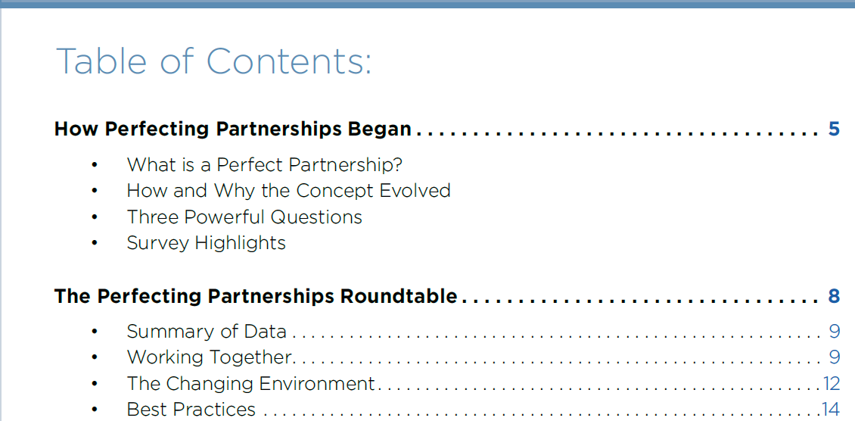
Quick Look at Electronic Book
Organized into three themes:
How to Build Long-Term Strategic Partnerships
Adapting to Changing Environments (ex. Technology)
3. Best Practices

Slide 6

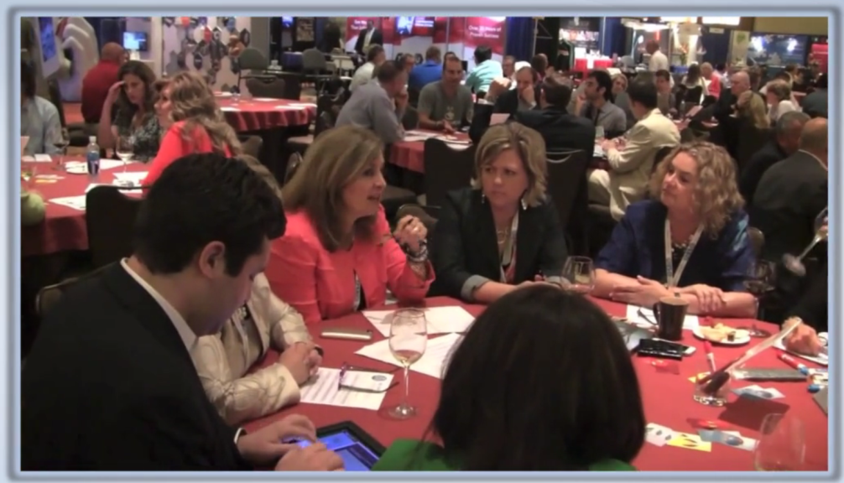

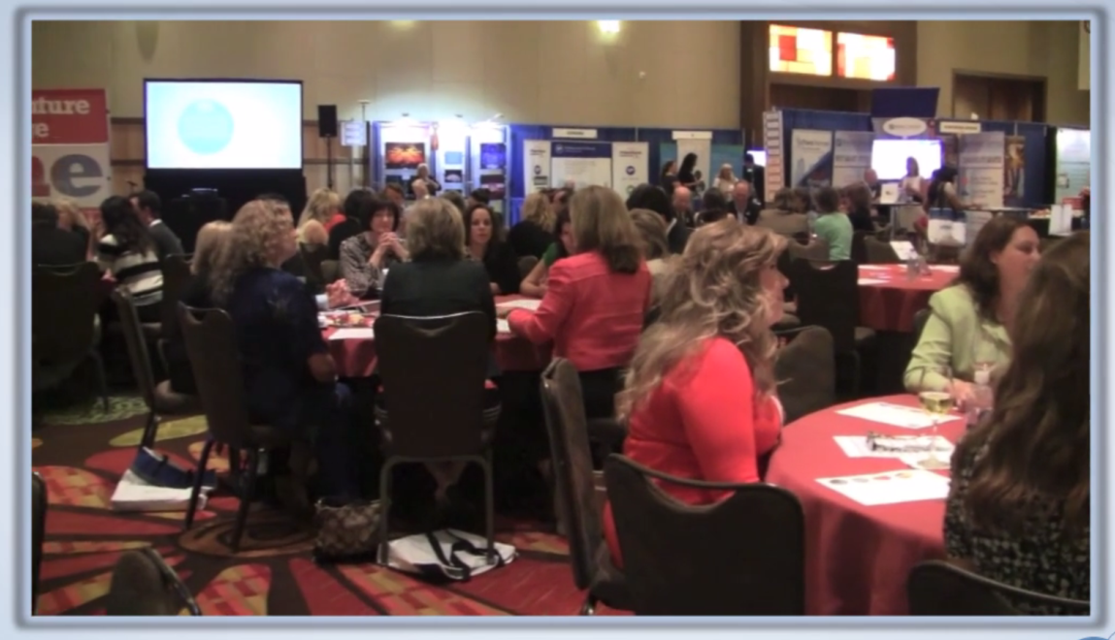
Quick Look at Screencast

Slide 7
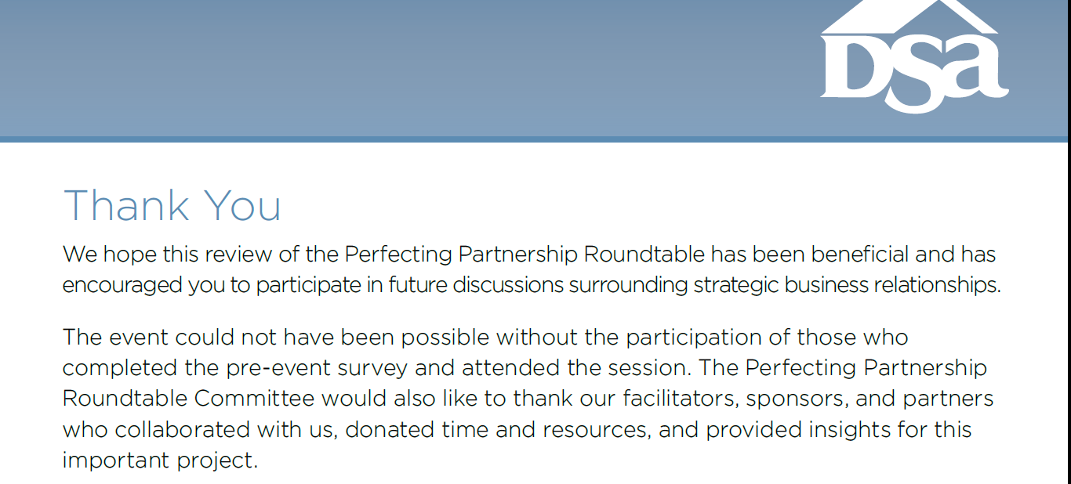
Thank You
Thank you to everyone who made the Perfecting Partnerships Roundtable possible, including many of you who participated as table facilitators.

