Slide 1
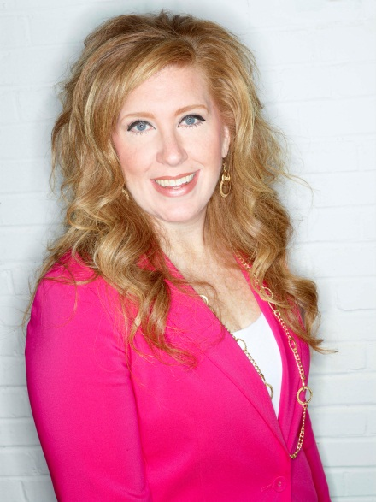
Britney Vickery
CEO & Founder, Initials, Inc.
Chairman, Education Committee

Slide 2
Education Committee Objectives
Identify member needs
  Current, New & Pending
  Member survey and assessment to update the current educational offerings
  Topics to include:
    Current Industry Topics
    Pressing Issues
    Trends
    Personal Development
    Best-In-Class
    Operational Functions

Slide 3
Education Committee Objectives
Embrace technology
  Implement an online training platform for Smart Start
    Expert-led content being the first sessions offered

Slide 4
Education Committee Objectives
Update Live Smart Start program
  Increase - direct peer-to-peer learning
  Minimize unnecessary vendor interactions

Slide 5
Education Committee Objectives
Partner Together
  Member Services Committee
    Start-up company focus
      Membership and education more accessible

Slide 6
Education Committee Objectives
Do More
  Expand the Committee’s focus to include deeper partnership with the DSEF
    Direct Selling Entrepreneur Program for community colleges
      Communications, Strategic Planning and Member Services Committees and current Board of Directors members to help bring this to life
  External educational focus
    Entrepreneurial opportunity business model
    Force for Good
    Build trust and credibility
  Educate using the power of our “Why”
    Why do we exist
    Why it matters

