Slide 3
Legal and Regulatory Updates
John Sanders Partner Winston & Strawn
Katrina Eash Partner Winston & Strawn

Slide 4
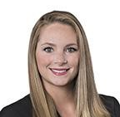
John Sanders & Katrina Eash
Recognized “Trailblazers” for their work defending direct selling companies, Winston Partners John Sanders and Katrina Eash’s specialty practice focuses on representing direct sales organizations in a wide range of disputes and consulting matters. They have successfully defeated class endless-chain and pyramid-scheme claims, enforced class-action waivers and arbitration agreements, enforced non-compete and non-solicitation agreements, prosecuted individuals violating their clients’ intellectual property rights, and counseled their clients on regulatory compliance issues and publicity crises. They also regularly advise clients undergoing government investigations, including those brought by the FTC.
John Sanders
jsanders@winston.com
+1 (214) 453-6462
Katrina Eash
keash@winston.com
+1 (214) 453-6477

Slide 5
Key Legal Updates
Success by Health & Lessons Learned From Same
The Rising Tide of Independent Contractor Misclassification Litigation

Slide 6
Success by Health & Lessons Learned From Same

Slide 7
FTC v. Success by Health (SBH)
The Allegations:
Illegal pyramid scheme
Misleading income claims
Related allegations
Outcome of Bench Trial (May 2023)
Liability found
Business enjoined
Executives enjoined

Slide 8
FTC v. SBH – Illegal Pyramid
Two-pronged test: an illegal pyramid scheme is any business model that requires participants to pay the business for:
(1) the right to sell a product and
(2) the right to receive rewards—unrelated to the sale of product—for the recruitment of others into the program.

Slide 9
FTC v. SBH – Illegal Pyramid
“[T]he evidence . . . overwhelmingly establishes that the second prong of the pyramid-scheme test is satisfied.”
The court cited six primary reasons for its finding:

Slide 10
FTC v. SBH – Illegal Pyramid
Paid commissions based on purchases made by distributors, rather than sales to end users.
Primary focus on recruiting; very little focus on retail sales to consumers.
95% sales decline after the court eliminated then-existing commission structure.

Slide 11
FTC v. SBH – Illegal Pyramid
Importance of distributor purchases to the business
Spikes in product purchases on the last day of the month
95% of products were purchased by distributors
Distributors “were economically incentivized (and aggressively encouraged) to use monthly purchases to maintain the ‘rank’ necessary to qualify for increased commissions”
Improbability that a distributor could earn a “significant source of income” from retail sales

Slide 12
FTC v. SBH – Illegal Pyramid
Other business practices indicative of a pyramid scheme
Failure to track distributors’ retail sales
Inadequate safeguards against inventory loading
No-refunds policy
Required (or strongly encouraged) monthly auto-orders

Slide 13
FTC v. SBH – Misleading Claims
Notable types of claims analyzed by the Court:
(1) offering “financial freedom,” or other lucrative rewards, to those who followed SBH’s instructions;
(2) Promising distributors that even if they did not want to push for “financial freedom,” they could still earn hundreds or thousands of dollars per month.
. . . . . Disclaimers regarding income did not prevent liability.

Slide 14
FTC v. SBH – Dr. Stacey Bosley
Used by FTC as an expert in many actions against direct sellers.
“On the whole, the Court found Dr. Bosley to be a credible and persuasive expert witness.”

Slide 15
The FTC’s Use of SBH
FTC cited SBH only five days after its issuance in its case against Neora.
Highlighted perceived similarities between Neora and SBH
Touted the Court’s credibility findings with respect to Dr. Bosley, who is an FTC expert in the Neora case

Slide 16
Reducing Exposure Post-SBH
Eliminate potentially misleading income and product claims from company marketing materials.
Publish an accurate and effective income disclosure statement.
Audit your company’s compliance functions and ensure your compliance team is monitoring for, and addressing, improper income and product claims in a timely manner.

Slide 17
Reducing Exposure Post-SBH
Maximize rewards driven by end-user sales, while minimizing recruitment-based rewards. Eliminate rewards solely based on recruitment.
Remove perceived “impediments” to retail sales.
Consider tracking retail sales.

Slide 18
Reducing Exposure Post-SBH
Consider prohibiting distributors from utilizing auto-ship.
Implement a “true undo” return policy.
Incentivize consumers who are not interested in the business opportunity to enroll as “preferred customers” rather than distributors.

Slide 19
The Rising Tide of Independent Contractor Misclassification Litigation

Slide 20
The “ABC” test
Dynamex Ops. W. v. Super. Ct., 4 Cal. 5th 903, 963 (2018)
The ABC test:
(1) The worker is free from the control and direction of the hiring entity in connection with the performance of the work, both under the contract for the performance of the work and in fact; and
(2) The worker performs work that is outside the usual course of the hiring entity’s business; and
(3) The worker is customarily engaged in an independently established trade, occupation, or business of the same nature as the work performed.
Failing to meet any one of these factors results in the worker being classified as an employee.

Slide 21
ABC Test – Common Issues
Because each factor is dispositive, courts may begin with any factor.
Second and third factor often more easily decided
Much more fact intensive to determine the level of control the company exerts (or could exert) on its sellers.
Second factor particularly tricky for MLMs.
Sellers are likely performing work within the usual course of the hiring entity’s business.
Plumbers fixing leaks in stores, specialty restorer working with general contractor and similar situated individuals to fall outside the usual course. See Dynamex, 232 Cal. Rptr. 3d at 44.
Put simply, one-off engagements between hiring entity and the individual

Slide 22
Direct Seller Exemption
California’s AB5, which codified Dynamex, contains a “Direct Seller” exemption to the ABC test.
The individual . . . is engaged in the trade or business of primarily in person demonstration and sales presentation of consumer products, including services or other intangibles, in the home or sales to any buyer on a buy-sell basis, a deposit-commission basis, or any similar basis, for resale by the buyer or any other person in the home or otherwise than from a retail or wholesale establishment.
Substantially all of the remuneration (whether or not paid in cash) for the services performed by that individual is directly related to sales or other output (including the performance of services) rather than to the number of hours worked by that individual.
The services performed by the individual are performed pursuant to a written contract between that individual and the person for whom the services are performed and the contract provides that the individual will not be treated as an employee with respect to those services for state tax purposes.
Cal. Lab. Code § 2783(e); Unemp. Ins. Code § 650

Slide 23
A case of copy & paste (sort of)
The direct seller language in the unemployment insurance code was taken from the Internal Revenue Code:
26 U.S.C. 2308(b)(2):
is engaged in the trade or business of selling (or soliciting the sale of) consumer products to any buyer on a buy-sell basis, a deposit-commission basis, or any similar basis which the Secretary prescribes by regulations, for resale (by the buyer or any other person) in the home or otherwise than in a permanent retail establishment,
is engaged in the trade or business of selling (or soliciting the sale of) consumer products in the home or otherwise than in a permanent retail establishment. . . .

Slide 24
Individuals Exempted
California law creates two classes of “direct sellers”:
individuals conducting primarily in person sales or demonstration or
individuals engaged in wholesale sales.
Limited cases interpreting the exemption confirms this reading.
See Salinas v. Cornwell Quality Tools Co., 635 F. Supp. 3d 954 (C.D. Cal. 2022).

Slide 25
Salinas v. Cornwell Quality Tools Co.
The Court held that the exemption applies only to individuals who are “engaged in the trade or business of primarily in person demonstration and sales presentation of consumer products, including services or other intangibles, in the home or sales to any buyer on a buy-sell basis, a deposit-commission basis, or any similar basis, for resale by the buyer or any other person in the home or otherwise than from a retail or wholesale establishment.” 635 F. Supp. 3d at 965-66 (emphasis in original).
Because the salespeople did not sell to resellers, only to end-users, they did not qualify for the direct seller exception.

Slide 26
Changing Nature of Direct Sellers
Language came from a time when in-home demonstration was more common
Today’s MLM’s are unlikely to fit within either exception.
Most sellers rely on social media, rather than in person demonstration
The products are sold to end users (as in Salinas), rather than to resellers.
Sellers are likely to be classified as employees under California law.
It’s not all bad news…

Slide 27
Outside Salespeople
Sellers may be near-textbook “outside salespeople”
One who customarily and regularly works more than half the working time away from the employer’s place of business selling tangible or intangible items or obtaining orders or contracts for products, services, or use of facilities. Ambrosia v. Cogent Comms., Inc., 312 F.R.D. 544, 553 (N.D. Cal. 2016).
“Outside salespersons” in California are exempt from statutory overtime, minimum wage, and meal-and rest break requirements. Espinoza v. Warehouse Demo Servs., Inc., 86 Cal. App. 5th 1184, 1191 (2022).
Limits damages

Slide 28
Rulemaking is Back in Style: Ongoing FTC Rules Impacting Direct Selling
Travis Wilson (Moderator) Director of Business Development Momentum Factor Jonathan Gelfand Executive Vice President, Business and Legal Affairs BODi Linda Goldstein Partner BakerHostetler Donnelly McDowell Partner Kelley, Drye & Warren LLP
Travis Wilson (Moderator) Director of Business Development Momentum Factor Jonathan Gelfand Executive Vice President, Business and Legal Affairs BODi Linda Goldstein Partner BakerHostetler Donnelly McDowell Partner Kelley, Drye & Warren LLP
Travis Wilson (Moderator) Director of Business Development Momentum Factor Linda Goldstein Partner BakerHostetler | Jonathan Gelfand Executive Vice President, Business and Legal Affairs BODi Donnelly McDowell Partner Kelley, Drye & Warren LLP

Slide 29
Update from SELDIA
Travis Wilson (Moderator) Director of Business Development Momentum Factor Jonathan Gelfand Executive Vice President, Business and Legal Affairs BODi Linda Goldstein Partner BakerHostetler Donnelly McDowell Partner Kelley, Drye & Warren LLP
Travis Wilson (Moderator) Director of Business Development Momentum Factor Jonathan Gelfand Executive Vice President, Business and Legal Affairs BODi Linda Goldstein Partner BakerHostetler Donnelly McDowell Partner Kelley, Drye & Warren LLP

Slide 30
GREETINGS FROM EUROPE
POLITICS
What Direct Selling Companies should get ready for.
POLICY
PREPAREDNESS

Slide 31
EU + US elections = Decisive year ahead for transatlantic relations

Slide 32
2024 Elections - OUTLOOK
BALANCE:
COMPOSITION:
CONTEXT:
Expected shift to the Right:
Center Right, Right, ECR, and far right groups
EPP, S&D, Renew are all expected to lose seats
Political agenda shifting away from Climate/environment to Security/Inflation/ Economy/Energy
More MEPs: 15 more MEPs will be selected between 12 countries, bringing the total to 720
It is expected that about 42% of MEPs will be re-elected
58% new MEPs:
33.5% new MEPs due to the turnover.
24.5% new MEPs due to the change of size of existing political groups
Spitzenkandidaten process likely to take place again, but likely won’t lead to anything.
Some chance Ursula von der Leyen may have a second term
Will take place under Belgium Presidency of the Council. Hungary from 1 July 2024.
Notes:
23

Slide 33
Notes:
5

Slide 34
2019- 2024: 6 Policy Priorities > 597 planned initiatives
1st priority – the European Green Deal = 148 initiatives

Slide 35
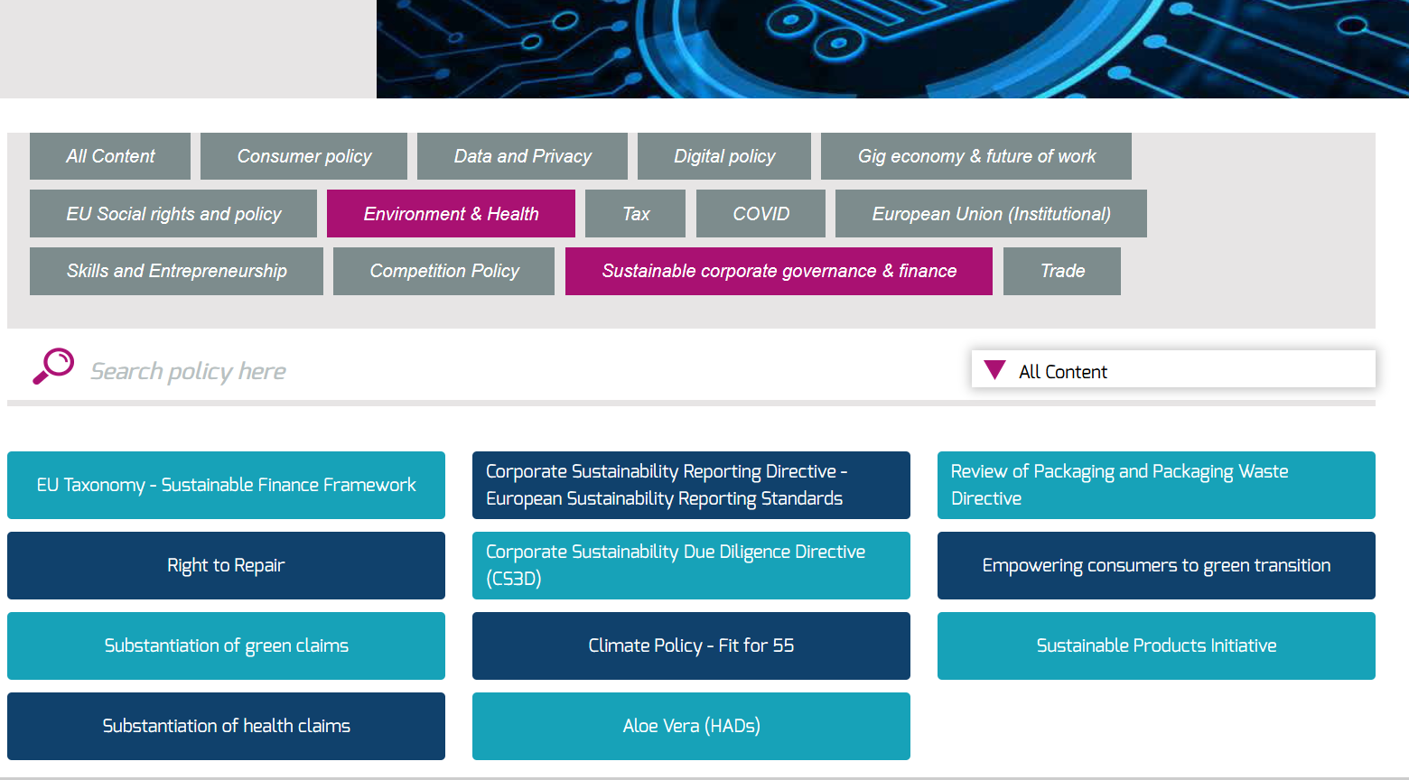

Slide 37
PPWR - Packaging and Packaging Waste Regulation

Slide 38
Empowering Consumers for the Green Transition
KEY PROVISIONS:
Provides a definition for environmental claims (important for Green Claims and potentially other upcoming legislation)
Introduced bans on certain practices:
Making environmental claims without evidence
Making environmental claims about the entire product or business, when it applies to a part
Using carbon offsets to claim that a product has a smaller impact
Certain marketing, online and durability-related issues (e.g. intentionally limiting a good’s durability, or omitting to inform a consumer of no spare parts)
3 May 2023: Council position adopted
Trilogue ongoing
11 May 2023: EP report adopted
Notes:
18

Slide 39
Green Claims Substantiation
KEY PROVISIONS
New public labels only permitted under EU law
New private labels need approval from Member States
Member States set up independent and third-party verifiers for claims, issuing certificates of conformity on a pre-approval basis
Besides products, corporate communications in business-to-consumer commercial practices are also covered
TIMELINE
Council and EP working on their individual positions
Council: Discussed on 3 April at the Working Party on the Environment, and WP on Consumer Protection and information
EP – Andrus Ansip was appointed rapporteur in IMCO and the proposal was discussed 23 May
(aspiration)
Notes:
19

Slide 40
Corporate Sustainability Due Diligence Directive
Companies obligations:
covers the whole value chain > own operations, operations of subsidiaries, and the value chain operations carried out by entities with which the company has a business relationship.
Incorporate due diligence into their policies
Identify potential adverse human rights and environmental impacts and mitigate those
Establish a complaints procedure
Publicly communicate on due diligence
The proposal also includes penalties and civic liability for violations of the obligations.
22 Dec: Council position
1 June: EP report adopted in 1st reading
Trilogue started in June. Next meeting end Nov.
Spain wants to finalise this file under their Presidency
Notes:
20

Slide 42
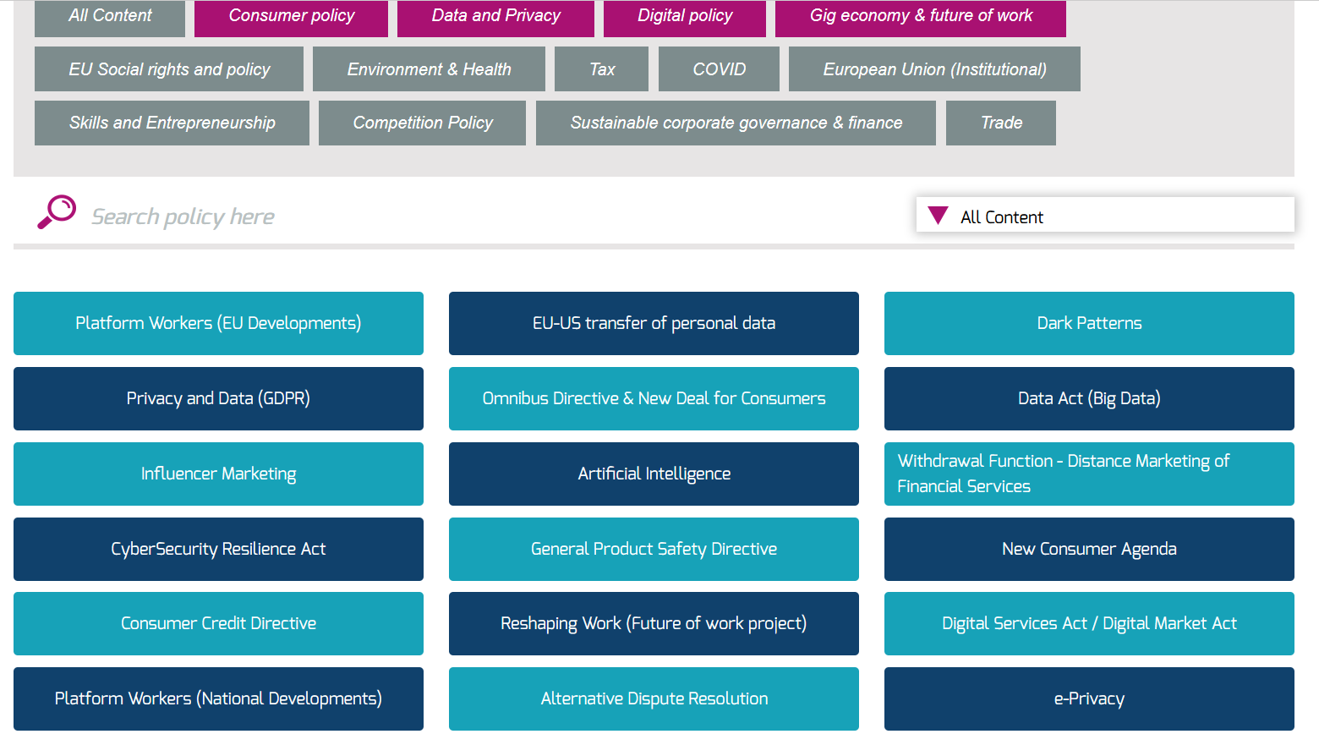

Slide 43
EU-U.S. Data Privacy Framework I Key provisions
Access to personal data
US intelligence agencies and authorities
Processing only for well-defined national security objectives
Proportionate
Redress of EU citizens
Civil Liberties Protection Officer
Data Protection Review Court
Notes:
15

Slide 44
EU-U.S. Data Privacy Framework I Key Dates
European Parliament adopts resolution 11 May
First challenge in Court by French MP 8 September
Commission adopts its adequacy decision 7 July
Notes:
16

Slide 45
DATA ACT (adopted in June)
AI ACT (in Trilogue)
Key provisions:
Access to non personal data from use of connected products
Sharing data with third parties
Guidance on compensation for making data available
Rules on Government access to data
Key provisions:
Risk based approach
Obligation to carry risk assessment for providers
Generative AI systems (like ChatGPT) must disclose that content was AI-generated and ensure safeguards against generating illegal content
Full ban on Artificial Intelligence (AI) for biometric surveillance, emotion recognition, predictive policing
Algorithms used to evaluate individuals’ credit scores, creditworthiness or insurance premiums were put in the high-risk basket.
Notes:
17

Slide 47
Fair conditions for Platform Workers | Next Steps
Trilogue started officially on July 11
Trilogues possibly to finish by end of year
First meeting today but many controversial points
Notes:
13

Slide 48
Review of EU Consumer Rules | Seldia Advocacy Actions
Seldia participates in Consumer Policy Advisory Group (CPAG)
ad-hoc meeting on combatting fraud online | 29 September
Next plenary meeting | 29 November
Seldia contributed to EC «Call for Evidence » on digital fairness
Seldia to contribute to targeted consultations on Omnibus and digital fairness
Spring 2024
Report on the implementation of Omnibus Directive
Report on outcome of Digital Fairness Review
2025/2026
Legislative proposal (s) to amend EU Consumer Directives
Notes:
8

Slide 49
Digital Fairness and Omnibus| Targeted Consultation
Doorstep selling
Seller's visit to consumer's home
No distinction between sollicited and unsollicted
Commercial excursions
leisure activities organised by a seller involving sales of products
Organised selling events
at places like private home, hotels, restaurants to which consumers are invited
Notes:
9

Slide 50
https://seldia.eu/2023-ipsos-survey-of-direct-sellers

Slide 53
Economic Analysis of Lawful Compensation Models
John Sanders Partner Winston & Strawn
Katrina Eash Partner Winston & Strawn
John Villafranco (Moderator) Partner Kelley, Drye & Warren LLP Branko Jovanovic Partner Edgeworth Economics | Bernadette Chala CLO/General Counsel Arbonne International, LLC Andrew Stivers Director NERA Economic Consulting

Slide 54
2023 Top Privacy and Cybersecurity Trends
Perspectives From The Inside Out

Slide 55
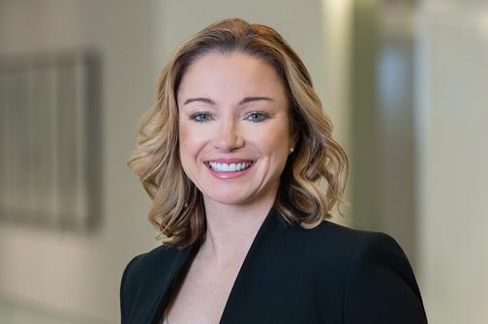
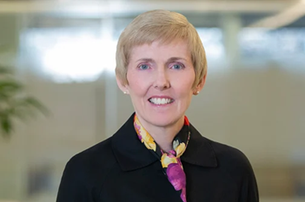
Speakers
Eric Ritter, Scentsy
Alex Kennedy, USANA
Shea Leitch
Of Counsel
Washington, DC
Katy Spicer
Partner
Washington, DC
Kathleen McGovern
Partner
Washington, DC

Slide 56
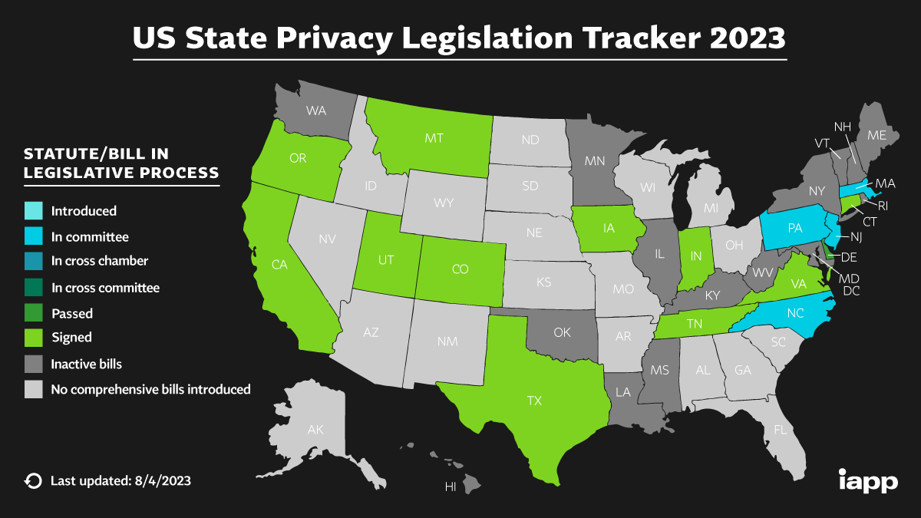
Patchwork Shuffle
State of play:
12 states have enacted comprehensive privacy laws
Other states have enacted more narrow laws
WA, NV, and CT health privacy laws
How to get a privacy/cyber program started and best practices:
Know your data
Know your data uses
Know your data disclosures
Mind your website, too
Data deletion – really?
Notes:
Shea/Alex/Eric:
-Shea provide overview of where regulatory shuffle stands.
-preemption considerations
-Alex/Eric provide insights to how to balance in-house/best practices for getting a privacy/cybersecurity program up and running.
-Eric talk about basics of getting started SOC2/ISO/PCI;
-Importance of data map/data flow. Know what you collect, use, share v. sell, store.
-Eric –IRS example – 1099 and warehousing separately
-shea/Eric – understanding sell v. share and how that impacts privacy program
-Data deletion policy:
-Shea talk about legal requirements.
-Eric/Alex discuss how this actually happens in-house. Much harder than a piece of paper.

Slide 57
Notes:
Alex to talk about building global privacy/cyber program.

Slide 58
Procurement Process Traps
Know the law and what is coming
That data map – what data is shared/sold and how it impacts risk assessment
The power of a vendor audit
Initial vendor due diligence
Does your DPA permit vendor audits? Under what circumstances?
How to work with procurement team
B2B litigation trends – words mean things!
Notes:
Shea: give update on state of law for data processing agreements and general best practices.
Eric/Alex: best practices with improving vendor management process in-house. Discuss process and how to train procurement folks to issue spot.
Katy: litigation trends. Will discuss rise of B2B disputes.

Slide 59
Cybersecurity
Importance of security assessment
Cybersecurity assessment is team effort between IT, legal, and relevant business stakeholders (HR, finance, marketing, sales, procurement)
Don’t forget operational technology!
Baseline cybersecurity program
Cybersecurity is more than having shiny security tools in place
People, process, and technology
Human element is involved in ~80% of data breaches—HR security processes, training, and DLP are essential
Incident response planning and response
IRP, IR preparation (tabletop exercises, penetration testing)
What’s happening with data breach litigation and regulatory enforcement?
Notes:
Shea and Alex to cover compliance and katy and Kathleen will cover litigation and enforcement

Slide 60
Enforcement Takeaways
Generally, regulators are more broadly interpreting existing cybersecurity regulations
U.S. regulators across all industries are leveraging authority to enforce cybersecurity regulations.
Ongoing increase in collaboration among regulatory agencies
E.g., FTC’s Criminal Liaison Unit referrals to DOJ
More targeted use of resources to focus on priorities, including cybersecurity enforcement
FTC’s emphasis on the importance of breach disclosures (May 20, 2022)
SEC - rules on cybersecurity risk management, strategy, governance, and incident disclosure by public companies
Rules require, among other things, current reporting about material cybersecurity incidents and annual reporting of material information re cybersecurity risk mgt, strategy and governance.
Failure to report can lead to SEC action
DOJ - potential prosecution for material misstatements or omissions in company’s financial statements
Notes:
kathleen
SEC - proposed cybersecurity risk management rules and amendments for registered investment advisors and funds (February 9, 2022) – see https://www.sec.gov/news/press-release/2022-20
The proposed rules would require advisers and funds to adopt and implement written cybersecurity policies and procedures designed to address cybersecurity risks that could harm advisory clients and fund investors.
The proposed rules also would require advisers to report significant cybersecurity incidents affecting the adviser or its fund or private fund clients to the Commission on a new confidential form.
The proposal would require advisers and funds to publicly disclose cybersecurity risks and significant cybersecurity incidents that occurred in the last two fiscal years in their brochures and registration statements.
SEC Proposes Rules on Cybersecurity Risk Management, Strategy, Governance, and Incident Disclosure by Public Companies – see https://www.sec.gov/news/press-release/2022-39
The proposed amendments would require, among other things, current reporting about material cybersecurity incidents and periodic reporting to provide updates about previously reported cybersecurity incidents.
The proposal also would require periodic reporting about a registrant’s policies and procedures to identify and manage cybersecurity risks; the registrant’s board of directors' oversight of cybersecurity risk; and management’s role and expertise in assessing and managing cybersecurity risk and implementing cybersecurity policies and procedures.
The proposal further would require annual reporting or certain proxy disclosure about the board of directors’ cybersecurity expertise, if any.
(Ericka) FTC – policy statement on the importance of effective breach disclosures (May 20, 2022) – see https://www.ftc.gov/policy/advocacy-research/tech-at-ftc/2022/05/security-beyond-prevention-importance-effective-breach-disclosures
FTC further announced that failure to disclose “information to help parties mitigate reasonably foreseeable harm may violate Section 5 of the FTC Act.”
Section 5 of the Federal Trade Commission Act (FTC Act) (15 USC 45) prohibits ‘‘unfair or deceptive acts or practices in or affecting commerce.’’
Under this section, an act or practice is unfair where it causes or is likely to cause substantial injury to consumers, cannot be reasonably avoided by consumers, and is not outweighed by countervailing benefits to consumers or to competition.

Slide 61
DOJ Recent Trends Cybersecurity Enforcement
Oct 2021- Announced the launch of its Civil Cyber-Fraud Initiative aimed at combating “new and emerging cyber threats to the security of sensitive information and critical systems” specifically targeting accountability of cybersecurity obligations for federal contractors and federal grant recipients
Verizon Business Network Solutions (Sept 2023)
Jelly Bean Communications Design LLC (March 2023)- Jelly Bean and its manager paid $293,771 to resolve allegations that they failed to secure personal information on a federally-funded Florida children’s health insurance website called HealthyKids.org, which was created, hosted, and maintained by Jelly Bean. 71.
Prosecuted Uber’s former Chief Security Officer for covering up data breach, involving millions of user records (October 2022) - Coordinated with the FTC
Notes:
Kathleen
Potentially discuss first enforcement action – March 8, 2022
https://www.subjecttoinquiry.com/2022/03/doj-settles-first-false-claims-act-enforcement-action-since-launch-of-civil-cyber-fraud-initiative/
$930,000 settlement with Comprehensive Health Services, LLC (CHS) for alleged violations of the False Claims Act (FCA). This settlement marks DOJ’s first resolution of an FCA enforcement action involving cyber fraud after launching its Civil Cyber-Fraud Initiative in October 2021, signaling DOJ’s eagerness to combat cybersecurity violations and misrepresentations
Specifically, DOJ alleged that CHS stored patients’ protected health information (PHI) and personal identifiable information (PII) on an electronic medical record (EMR) system that was, at times, unsecured, in violation of express contractual requirements.
On May 20, 2022, the Federal Trade Commission issued a blog post titled “Security Beyond Prevention: The Importance of Effective Disclosures.”
The FTC announced that the Federal Trade Commission Act, codified as 15 U.S.C. § 45, may “create a de facto breach disclosure requirement” for companies that experience a compromise of consumer data.
Section 5 of the FTC Act prohibits ‘‘unfair or deceptive acts or practices in or affecting commerce.’’
The FTC therefore reasons that “a breached entity that fails to disclose information to help parties mitigate reasonably foreseeable harm may violate Section 5 of the FTC Act,” by amounting an unfair or deceptive act or practice.
The FTC therefore broadly interprets the FTC Act to provide the FTC with the authority to implement a federal breach notification law for organizations.
Chegg (Jan 2023)- Found that Chegg failed to protect personal information that it collected from users and employees.
Required Chegg to implement a comprehensive info security system, limit the data it can collect and retain; and allow users to request access and deletion of their own data
Drizly LLC (Jan 2023)- Issued order that its CEO failed to secure customers’ data after being alerted to vulnerability two years prior leading to breach exposing personal info of 2.5m consumers; required to take remedial measures including public disclosures of collection of data and implementing comprehensive info security system.
CaféPress (June 2022)- Fined former owner $500K for failure to implement reasonable security measures to protect information on its network, including Social Security numbers, and for covering up breach.
Health Data Breach Notification Rule
Recognizing that Americans turn to apps and other technologies to track diseases, diagnoses, treatment, medications, fitness, fertility, sleep, mental health, diet, and other vital areas.
Requires certain organizations (both businesses and nonprofits) not covered by HIPAA to notify:
customers, FTC and in some cases, the media
For a breach of unsecured, individually identifiable health information.
Recent enforcement actions:
GoodRx (Feb. 2023) - FTC alleged that GoodRx, a direct-to-consumer telehealth and prescription drug discount provider, failed to notify consumers of its unauthorized disclosures of consumers' personal health information to Facebook, Google and others. GoodRx will be permanently prohibited from sharing user health data with third parties for advertising purposes. GoodRx is required 1) to obtain users' express consent before disclosing user health information with third parties; 2) direct third parties to delete the consumer health data shared with them and inform consumers about the breaches; 3) limit how long it can retain personal and health information and; 4) adopt a comprehensive privacy program.
Premom (May 2023) - FTC alleged that Premom, the developer of the fertility app deceived users by sharing their sensitive personal information with third parties, and would be barred from sharing users’ personal health data with third parties for advertising, required to obtain users’ consent before sharing health data for any other purpose, and must tell consumers how their personal data will be used.
Issue arose for Premom and GoodRx due to data transferred via SDK or advertising pixels on app or website
Understanding data disclosures is crucial
Data leakage—do you know what you’re sharing with third parties?
Sharing sensitive data without affirmative, express consent
What can be inferred about the individual from the data you share?
In the case of Premom, it was the most intimate details of users’ life, like sexual activity, reproductive health, pregnancy status, and health information.
For GoodRx, it was information regarding health conditions and prescription medication.

Slide 63
And More
U.S. Securities & Exchange Commission (“SEC”)
Increasing focus on cyber disclosures as an enforcement priority
Blackbaud (April 2023)- The cloud computing company agreed to pay a $3-million civil penalty for alleged materially misleading disclosures about a 2020 ransomware attack
U.S. Health and Human Services (“HHS”)
HHS- OIG formed a multidisciplinary Cybersecurity Team focused on combatting cybersecurity threats within HHS and the healthcare industry.
Lifetime Healthcare Companies (Jan 2021)- Fined $5.1 Million to settle data breach affecting over 9.3 million people.

Slide 64
Investigation Best Practices
Investigative Demands- Include voluntary requests, subpoenas, etc.
Conduct internal investigation to determine the facts and remediate any issues as soon as possible
You can’t determine the best course of action if you don’t know what happened
Understand relationships among all regulators, including FTC, HHS, DOJ, etc.
Ability to share information usually through access requests
Increasing coordination: Run parallel investigations and coordinated resolutions
Talking to regulators- understand different applicable statutes, applicable policies, remediation and resolution
Be proactive

Slide 65
Investigation Best Practices
Cooperation- numerous cooperation policies
Self disclosure, full cooperation and remediation
Even if not cooperating
Need to control the narrative
Detect, fix and prevent – don’t wait for regulators to tell you what to do
Executive (and board) liability in corporate matters
Prosecution of Business Entities (Justice Manual) factors
Company is liable for acts of its employees
Focus on holding both entity and individuals accountable
How company and executives handled the investigation from Day One changes the resolutions (examples)
Notes:
kathleen

Slide 66
Privacy Litigation Trends
Pre-demand
Where’s the action right now: systems that record and share
Session Replay
Chat/video programs
Pixels
Popular Theories of Liability
Horizon Scanning:
B2B disputes
AI litigation
Shareholder disputes
Competitor claims
Notes:
Katy
Company suffers data breach
March 24, 2023: OpenAI publicly discloses security incident
Class action lawsuits follow
June 28, 2023
Regulatory Scrutiny
FTC CID July 13, 2023

Slide 67
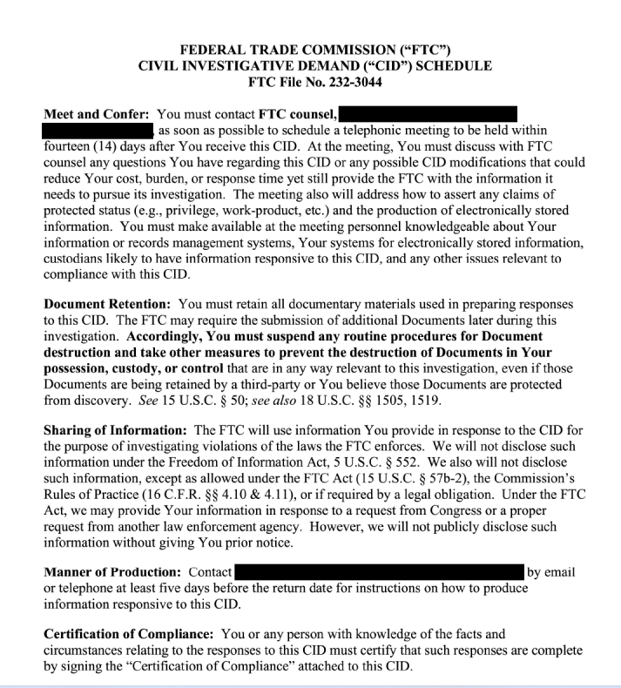
FTC OpenAI CID
Section 5 of FTC Act:
“offering” or “making available”
“incorporating”, “using”, or “relying on”
unfair or deceptive “privacy or data security practices”
unfair or deceptive practices relating to risks of harms to consumers, including reputational harm
Notes:
Katy
FTC Guidance in 2023¹
FTC updated previous guidance issued in 2020 and 2021.
Focus: guidance was on false or unsubstantiated claims about a product’s efficacy . This includes claims involving the abilities of AI and how it may violate the FTC.
Much of the 2023 guidance also focuses on whether companies are considering the foreseeable risks of using generative AI in their products. The 2023 guidance also emphasizes that companies may be held liable for the actions of third party generative AI developers.
FTC Guidance in 2021²
The FTC’s 2021 guidance focused on the benefits of generative AI while also acknowledging the potential introduction of bias or harm.
Recommended best practices to avoid violations of Section 5 of FTC Act that prohibits unfair and deceptive practices such as the “sale or use of racially biased algorithms.”
FTC Guidance in 2020 ³
The FTC’s 2020 guidance focused on the ethical concerns of generative AI and transparency issues with customers. The guidance also examined compliance with the Fair Credit Reporting ACT (FCPRA) and Equal Credit Opportunity ACT (EOCA).
The 2020 guidance emphasizes the need for companies to be transparent to customers and inform them of how their information is being stored and used.
The 2020 guidance also examined potential issues with discrimination and bias.

Slide 68
What Does FTC Discovery Teach Us
Transparency first
Detail the related Security Incident identified in public notice
Disseminated advertisements – proof of clear and conspicuous notice to consumers
Governance Program
All types of Personal Information collected, used, and stored
Corporate Governance Model
Policies and procedures to assess risk and safety
Complaint process
Human review and supervision of data
Steps taken to prevent Personal Information from being included
Consumer understanding before implementation
Know your data
Each LLM provided, offered, or made available
All third parties with “use” or “access” to LLM, paid or unpaid
Data used to train (scraping, third parties, public, vetting)
API Integrations
Notes:
Katy

Slide 69
Key Benefits to Arbitration Agreement
Class action waiver:
Keller v. Chegg, Inc., 2023 WL 5279649 (N.D. Cal. Aug. 15, 2023) (enforcing class action waiver and requiring individual arbitration).
Enforceability of class action waiver must be resolved prior to class certification. See In re Marriott Inter., Inc., 2023 WL 5313006 (4th Cir. Aug. 18, 2023).
Issues of arbitrability can be delegated to arbitrator:
Torres v. Veros Credit LLC, 2023 WL 5505887 (N.D. Cal. July 13, 2023).
Denial of arbitration motion provides for immediate right of appeal under FAA and stay of proceedings:
Coinbase, Inc. v. Bielski, 143 S. Ct. 1915 (2023).
Notes:
Katy

Slide 70
Risks of Mass Arbitrations
No judicial relief. See, e.g., Abernathy v. DoorDash, Inc., 438 F. Supp. 3d 1062 (N.D. Cal. 2020).
Can a company mitigate the risks?
Informal dispute resolution provisions.
Small claims court options.
Remove certain threshold issues from delegation clause.
Alternative arbitration provider.
Individual filing requirements to deter unmeritorious claims.
Do not agree to pay all arbitration filing fees.
Assess likelihood of mass arbitration claims.
Notes:
Katy
Enforceability – now what? Mass arbitrations.
Every class member must have Article III standing in order to recover individual damages.” Transunion LLC v. Ramirez, 141 S. Ct. 2190, 2208 (2021).
Green-Cooper v. Brinker Int’l, Inc., 73 F.4th 883 (11th Cir. 2023):
Two named plaintiffs lacked standing because injury not fairly traceable to defendant.
Vacated class certification and remanded back to district court to clarify predominance analysis because class definitions may include uninjured individuals.
Van v. LLR, Inc., 61 F.4th 1053, 1069 (9th Cir. 2023):
Vacated class certification and remanded back to district court to determine whether individual issues surrounding absent class member injury predominate and preclude class certification.

Slide 73
Revolutionizing Compliance: Staying Ahead of the Curve
Brent Kugler (Moderator) Partner Scheef & Stone LLP LaRane Jensen Director, Compliance LifeVantage Larry Steinberg Shareholder Buchalter | Matt Cagle Senior Vice President & General Manager CompliancePoint Justin Powell Chief Legal Officer & General Counsel Market America, Inc.

Slide 74
Real Life: Working for a FTC Commissioner
Brian Bennett Senior Vice President, Government Affairs & Policy Direct Selling Association Nina Frant Vice President, Consumer Policy United States Chamber of Commerce

Slide 78
Update from the Direct Selling Self-Regulatory Council
Gayla Huber President Integrishield Peter Marinello Vice President Direct Selling Self-Regulatory Council BBB National Programs Howard Smith Senior Staff Attorney Direct Selling Self-Regulatory Council

Slide 79
DSSRC By The Numbers
Number Of Inquiries Opened Since 2019 - 459
Number Of Representative Claims:
Product Claims:1,416
Earnings Claims: 1,861
Number Of Inquiries Involving DSA And Non-DSA Members:
DSA Members: 236
Non-DSA Members: 223
Number Of Cases Referred To Government – 25
Participation Rate – 95%

Slide 80
Questions

Slide 81
How Far Does the Law Go? Insights from a Former FTC General Counsel
Alden Abbott Senior Research Fellow Mercatus Center Daniel Kaufman Partner BakerHostetler

Slide 82
Update from the Federal Trade Commission
Lois Greisman Associate Director, Division of Marketing Practices Federal Trade Commission

Slide 83
QUESTIONS?
Email bbennett@dsa.org

