Slide 1


Slide 2


Slide 3


Slide 4
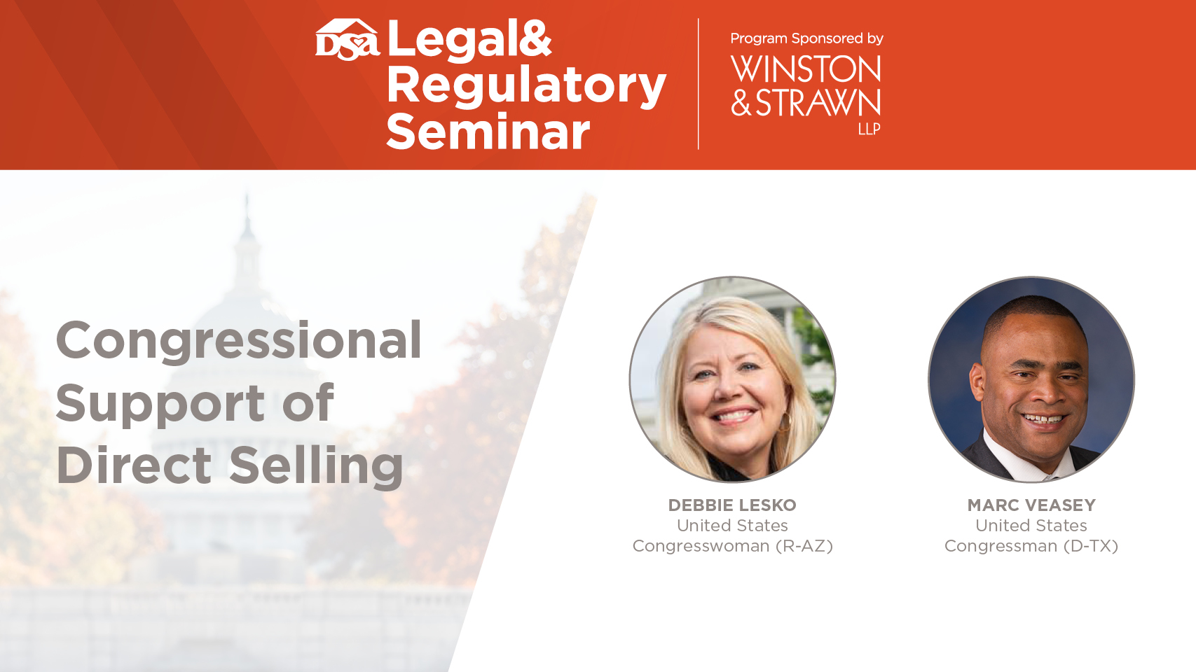

Slide 5
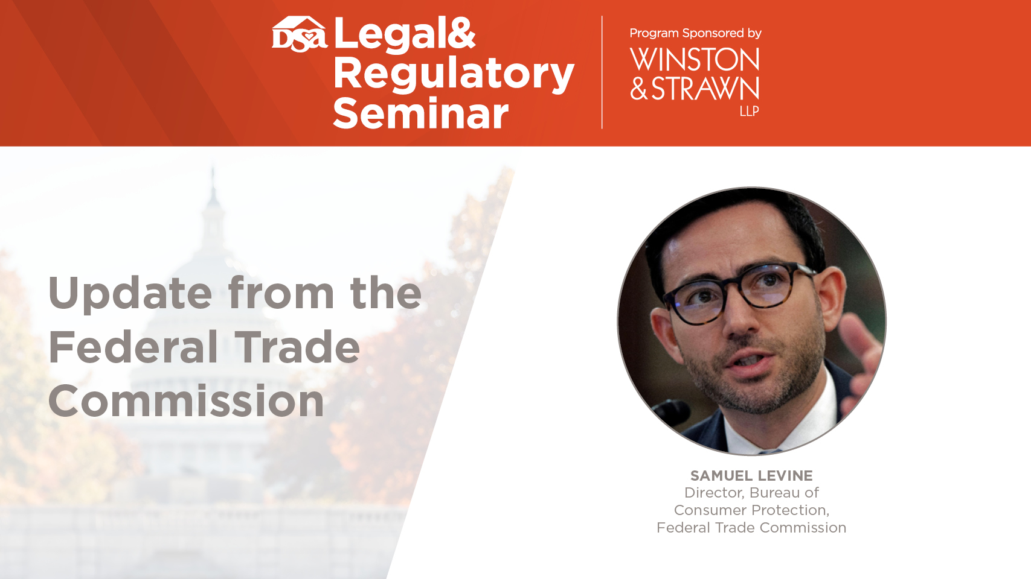

Slide 6


Slide 7
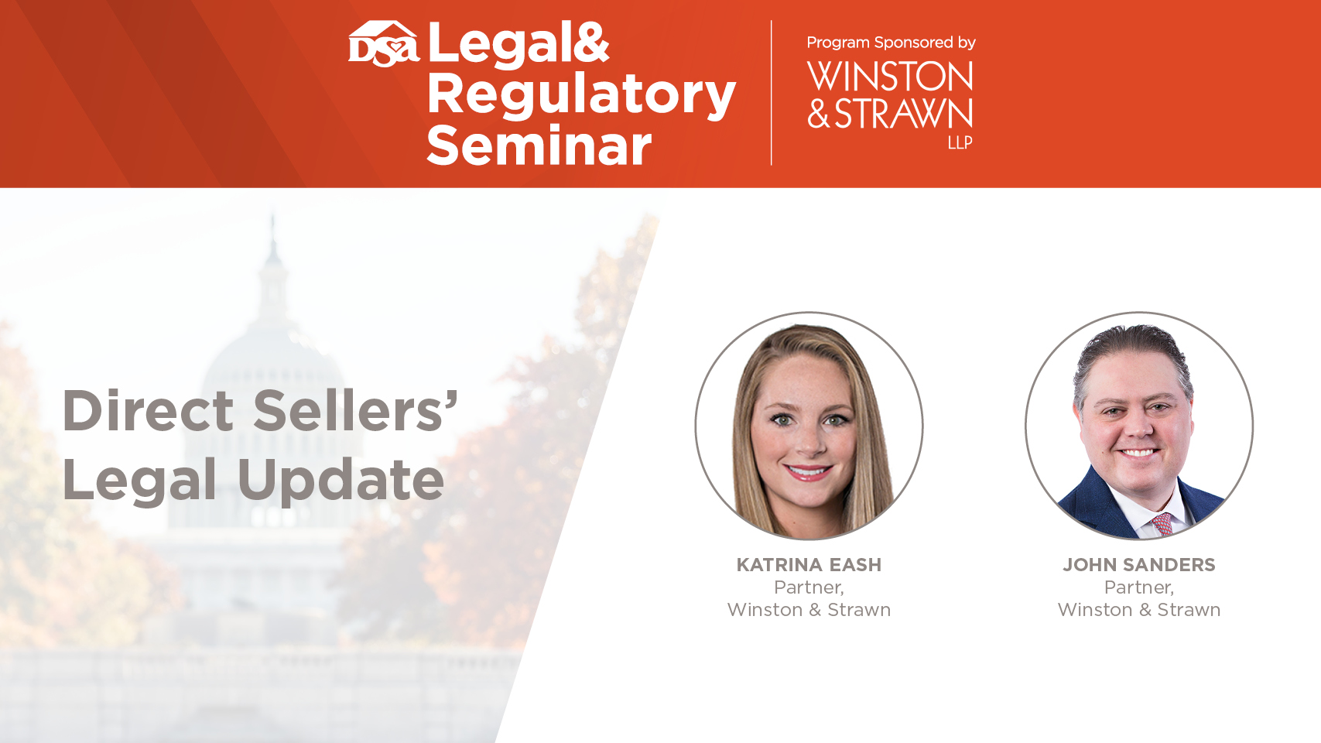

Slide 8


John Sanders & Katrina Eash
Recognized “Trailblazers” for their work defending direct selling companies, Winston Partners John Sanders and Katrina Eash’s specialty practice focuses on representing direct sales organizations in a wide range of disputes and consulting matters. They have successfully defeated class RICO and securities claims, enforced non-compete and non-solicitation agreements, prosecuted individuals violating their clients’ intellectual property rights, and counseled their clients on regulatory compliance issues and publicity crises. They also regularly advise clients undergoing government investigations, including those brought by the FTC.
John Sanders
jsanders@winston.com
+1 (214) 453-6462
Katrina Eash
keash@winston.com
+1 (214) 453-6477

Slide 9
Legal Updates
Direct Seller Class Action Update
  The LifeVantage Class Action
  Distributor Misclassification Class Actions
  Significant Direct Seller Class Settlements
FTC Enforcement Actions
  The Botched TRO Against Financial Education Services
  The FTC’s Action Against Neora
Distributor Poaching Actions
Notes:
Intro -- John
LV – John
Distributor misclassification section – Katrina
AdvoCare & Herbalife – John
FTC Enforcement actions – Kat
Distributor Poaching -- John

Slide 10
Direct Seller
Class Action Update

Slide 11
The LifeVantage Class Action
The Allegations:
  Illegal pyramid scheme
  False product, earnings, and lifestyle claims
  Violations of the Securities Exchange Act
  Unjust enrichment
Class claims on behalf of “at least 200,000 Distributors”
Notes:
Securities Exchange Act allegations:
Selling distribution rights equates to selling securities
Defendants omitted material facts and made misrepresentations concerning the securities they were selling
Defendants failed to register with the SEC

Slide 12
The LifeVantage Class Action
Class Certification Denied
Notes:
In April 2022, Winston & Strawn secured an order denying class certification for LifeVantage.
The two plaintiffs in the case sought to represent over 200,000 LifeVantage distributors who had allegedly lost money.
If this class were to be certified, the potential damages were enormous.

Slide 13
The LifeVantage Decision
Distributor-consumed products are not valueless:
  “Even if . . . no distributor would have bought and consumed products absent the requirement to do so, that does not inexorably mean that the products they did consume were inherently worthless. Thus, counting products that were consumed by distributors as an unmitigated loss seems illogical on its face.”
Notes:
Specifically, we were able to show that the alleged damages were not ascertainable on a class-basis.
The court agreed with us that distributor consumption and the possibility of hand-to-hand resale could widely vary the damages that the plaintiffs were claiming. In fact, the court even agreed that consumption could be viewed as a value to the distributor.
Because different distributors had different levels of consumption or hand-to-hand sales, they would have experienced different monetary gains or losses. Thus, they could not be grouped together in considering damages, if any even existed.

Slide 14
The LifeVantage Decision
The absence of data on distributor consumption does not render such consumption valueless:
  “[T]he present absence of extensive data on distributors’ personal consumption does not mean the effect such data would have on the calculation of damages in this case is purely hypothetical.” . . . .
  The need for information concerning each distributor’s personal consumption “deals a heavy blow to the argument for certifying this massive nationwide class.”
Notes:
Specifically, we were able to show that the alleged damages were not ascertainable on a class-basis.
The court agreed with us that distributor consumption and the possibility of hand-to-hand resale could widely vary the damages that the plaintiffs were claiming. In fact, the court even agreed that consumption could be viewed as a value to the distributor.
Because different distributors had different levels of consumption or hand-to-hand sales, they would have experienced different monetary gains or losses. Thus, they could not be grouped together in considering damages, if any even existed.

Slide 15
The LifeVantage Decision
The potential for hand-to-hand resale cannot be ignored:
  Even though “there was much less incentive for distributors to resell products hand-to-hand than through distributor channels[,] . . . the potential rarity with which such retail sales occurred does not warrant dismissing them out of hand when calculating damages.”
Notes:
Specifically, we were able to show that the alleged damages were not ascertainable on a class-basis.
The court agreed with us that distributor consumption and the possibility of hand-to-hand resale could widely vary the damages that the plaintiffs were claiming. In fact, the court even agreed that consumption could be viewed as a value to the distributor.
Because different distributors had different levels of consumption or hand-to-hand sales, they would have experienced different monetary gains or losses. Thus, they could not be grouped together in considering damages, if any even existed.

Slide 16
The LifeVantage Impact
What does this mean for direct sellers?
  Legal precedence rejecting the FTC’s position that distributor consumption and hand-to-hand retail sales cannot be considered in calculating end-user consumption.
  Makes certifying a class on pyramid scheme claims extremely difficult for direct sellers that sell products.
  Legitimizes direct selling companies, like LifeVantage.
Notes:
LifeVantage’s win here is significant because the elements addressed by this court will apply across other legitimate multi-level marketing companies.
To determine damages, the consumable products bought by the distributor, whether or not as a requirement of the distributorship program, cannot be disregarded as having zero value to the purchaser.
In addition to the certification components, the implications of the decision in this case help to demonstrate that LifeVantage, and similarly situated direct selling companies, are legitimate companies and not pyramid schemes, contrary to the plaintiffs’ allegations. The court acknowledged that many distributors wanted to purchase and consume products as part of their distributorship and that many became distributors because they liked and valued the products.
The court distinguished between “a legitimate multi-level marketing company offering actual products and services” and a pyramid scheme that has “no legitimate revenue stream

Slide 17
Distributor Misclassification
Class Actions

Slide 18
SCOTUS Viking River Decision
Decided June 2022.
Huge win for direct sellers that might face claims from California workers alleging employment status.

Slide 19
SCOTUS Viking River Decision
California’s Private Attorney General Act (PAGA) allows an “aggrieved employee” to bring claims as a representative of the state against her employer—on behalf of herself and others.
Recoveries for violations experienced by an individual employee are usually relatively small, but claims brought on behalf of other workers can multiply to become very large.

Slide 20
SCOTUS Viking River Decision
California state courts had held that the statutory right to bring PAGA claims on behalf of other employees could not be waived by contract—i.e., direct sellers could not enforce the class action waivers in their arbitration agreements when such claims were brought.
The Supreme Court disagreed, holding the FAA requires enforcement of agreements to arbitrate on individual basis.
Employees may still arbitrate their individual PAGA claims.
Notes:
The decision was 8-1. Justice Thomas’s dissent was rooted in his long-held minority view that the FAA should not apply to proceedings in state courts.
The Court held that the FAA preempted state case law that had precluded division of PAGA actions into individual and non-individual claims. That is, the Court determined that California law prohibiting wholesale waiver of PAGA claims is not preempted by the FAA, but (1) agreements to arbitrate PAGA claims are enforceable; (2) agreements not to arbitrate non-individual claims for alleged violations experienced only by other employees are enforceable; and (3) state law prohibiting the division of arbitral and non-arbitral claims is preempted by the FAA.
As a result, the Court ordered that Moriana be compelled to arbitrate her individual PAGA claims. The Court further determined that PAGA did not provide standing for an employee to bring claims only on behalf of other employees when the employee herself did not suffer from at least one alleged violation. The Court thus determined that Moriana’s remaining non-arbitral non-individual claims must be dismissed.
Justice Sotomayor noted in a concurring opinion that California courts may disagree that state courts do not have standing to hear only non-individual PAGA claims by an employee—and even if they do agree, the legislature could amend the law to expressly grant such standing.

Slide 21
Viking River Impact
Direct sellers should carefully review dispute-resolution provisions in agreements with their distributors to ensure there is language requiring individual-only arbitration.
This is an ever-evolving area of law, and legislatures and courts may find ways to circumvent this decision.

Slide 22
Viking River Impact
Relying on Viking River, Amway has filed a motion to compel individual arbitration in its PAGA suit, pending in California. Amway is demanding the representative claims be dismissed once the motion is granted
  Motion hearing on October 5
It Works! will be doing the same soon.

Slide 23
Innovative Efforts to Avoid Mass Arbitration
Two novel approaches:
  Bellwether procedures:
    Provides that only a certain number of similar arbitration claims (e.g., 10) may proceed at one time. When one case resolves, another may take its place.
    If an individual shows “substantial hardship” she may move to the front of the line, but no more than the designated max number of cases can proceed at one time without company’s consent.
Notes:
In recent years, as companies have become more successful in preventing class action lawsuits and multi-plaintiff arbitration, plaintiffs’ lawyers have also gotten more creative.
Mass arbitration is where a law firm simultaneously brings hundreds or thousands of individual arbitrations against a company.
The arbitration fees alone can be incredibly expensive for companies, even if the claims are meritless.
Recent examples include Amazon (75,000 claims), Intuit (40,000 claims), and Uber (12,500 claims).
https://www.natlawreview.com/article/retail-industry-2021-year-review-retail-giant-drops-arbitration-clause-right-move

Slide 24
Innovative Efforts to Avoid Mass Arbitration
Two novel approaches:
  Batch arbitration:
    Provides that similar claims will proceed in batches (e.g., 25 per batch), with only one arbitration fee per batch.
    Sometimes limits to only one batch at a time.
Notes:
In recent years, as companies have become more successful in preventing class action lawsuits and multi-plaintiff arbitration, plaintiffs’ lawyers have also gotten more creative.
Mass arbitration is where a law firm simultaneously brings hundreds or thousands of individual arbitrations against a company.
The arbitration fees alone can be incredibly expensive for companies, even if the claims are meritless.
Recent examples include Amazon (75,000 claims), Intuit (40,000 claims), and Uber (12,500 claims).
https://www.natlawreview.com/article/retail-industry-2021-year-review-retail-giant-drops-arbitration-clause-right-move

Slide 25
Innovative Efforts to Avoid Mass Arbitration
These innovative approaches are new and are relatively untested in the courts; but we expect a lot of legal challenges.
Recent court found a bellwether provision unconscionable—and rendered the entire arbitration agreement unenforceable. MacClelland v. Cellco P’Ship (N.D. Cal. July 1, 2022).
It’s very important to think creatively and holistically (including strategic drafting of seemingly unrelated provisions, such as venue and forum-selection clauses) to reduce the most risk.
Notes:
MacClelland: The primary reasoning for the court’s ruling was the risk of delay in non-test-group consumers’ ability to arbitrate their claims. Id. (“Delaying the ability of one to vindicate a legal claim by years, possibly 156 years, ‘conflict[s] with one of the basic principles of our legal system—justice delayed is justice denied.’”). The court raised the issue that the SOL could run before the consumer was contractually allowed to file for arbitration. However, it also found that the delays were generally unconscionable, regardless of the SOL issue. The plaintiffs had argued that, given the 7-month average time for arbitration, it could take the company’s 2,712 customers up to 156 years to have their claims heard.

Slide 26
Significant Direct Seller Class Action Settlements

Slide 27
The AdvoCare Settlement
Allegations:
  Class action alleging AdvoCare operated a pyramid scheme that utilized false earnings claims to recruit participants.
Causes of Action:
  Racketeering activity – RICO 18 U.S.C. §§ 1961 and 1962
  Federal securities fraud
  Unjust enrichment

Slide 28
The AdvoCare Settlement
Parallel Cases
  FTC Action
    Settled in 2019 for $150M
    Prohibited from future multilevel compensation models
  Private Class Action
    Settled in 2021
Notes:
Advocare was sued first by the FTC and then by a private class of distributors.
Given the parallel cases, and the fact that the private class plaintiffs could potentially use the settlement amount with the FTC as evidence, the class action became very risky.
However, we were able convince them to settle with favorable terms to AdvoCare

Slide 29
The AdvoCare Settlement
Private Class Action Settlement Details:
  $10.5M
  Opt-in requirement
  Claim presentation
  FTC distribution offset
  Reversionary
Notes:
We shared two primary arguments that we would make to the judge that convinced the plaintiffs to settle: (1) the class is not certifiable; and (2) the claim cannot stand because plaintiffs’ recovery from the FTC case would constitute double recovery.
Because of these arguments we were able to craft a more favorable settlement;
The damages amount is substantially less than the FTC case
Class members seeking compensation must opt in to the class and present their claims
Any damages that any Plaintiff was entitled to would be reduced by the amount that they recievd from the FTC
Any of the leftover money would revert back to AdvoCare, if all of it was not claimed within a certain time.

Slide 30
The Herbalife Settlement
Allegations:
  Class action alleging Herbalife promotes and sells expensive tickets to monthly events based on representations that success is contingent on attendance.
Causes of Action:
  Racketeering activity - RICO 18 U.S.C. § 1962(C)
  Violation of CA’s unfair competition law
  Negligent misrepresentation
Notes:
Next, I want to talk about a recent settlement obtained by Herbalife in a significant class action filed against it.
First, it’s worth mentioning a little background on legal issues Herbalife has faced in the past. Most significantly, in 2016 Herbalife reached a $200M settlement with the FTC based on allegations that the majority of its distributors made little or no money. Without admitting any wrongdoing, Herbalife agreed to implement various changes to bring its business model within FTC compliance. The changes mostly involved representations about the income and lifestyle its distributors could expect, and compensation based on product sales rather than recruiting new members.
Then in September 2017, 8 individuals filed a class action in S.D. Fla. against Herbalife and at least 43 individuals identified as “top distributors” in court documents. That’s the case and ultimate settlement we’ll be talking about today. Plaintiffs allege that Herbalife promotes and sells expensive tickets to monthly events based on representations that success is contingent on attendance. Plaintiffs allegedly spent thousands of dollars each to attend corporate events and received no benefit from doing so, despite Herbalife and its distributors’ alleged guarantees to the contrary. The causes of action include a RICO claim, violation of CA’s unfair competition law, and negligent misrepresentation.
[Slide]
In August 2018, the Court split the case into three separate parts. First, all claims against the individual defendants would remain in S.D. Fla. Second, the Court granted a motion to compel arbitration as to 4 of the 8 plaintiffs’ claims against the Herbalife Corporate Defendants because they had signed a Distributor Agreement with a valid arbitration clause. Third, the Court granted a motion to transfer venue as to the remaining 4 plaintiffs’ claims against the Herbalife Corporate Defendants because they had signed a Distributor Agreement with a valid forum selection clause. The case in C.D. Cal. is where the settlement agreement that we’ll be discussing today takes place.
In September 2021, the S.D. Fla. Court overseeing the case against the individual defendants granted in part a motion to dismiss brought by Herbalife that significantly reduced, but didn’t eliminate, the claims against them. It’s highly likely that this played a role is moving the settlement negotiations forward.
In December 2021, the C.D. Cal. Court granted a joint stipulation to continue certain hearing dates based on a likely settlement.
Then a month later, the S.D. Fla. Court stayed that case pending final approval of the settlement in C.D. Cal.
Two months after that, the parties in C.D. Cal. Filed a joint status report that settlement had been reached in principle. And by June 2022, the C.D. Cal. Court stayed the case pending final approval of settlement. As of August 2022, the Court continued the motion for preliminary settlement approval until October 24th. So as of now the settlement has not officially been approved.
Note that the C.D. Cal. Court had not certified the class yet. But the Court anticipates certifying a settlement class upon final approval of the settlement.
[Slide]

Slide 31
The Herbalife Settlement
Procedural Posture
  Claims split up and sent to various venues early in litigation.
  Claims settled prior to class certification ruling.
  California litigation is where all class claims will be settled, and other litigations will be dismissed accordingly.
Notes:
In August 2018, the Court split the case into three separate parts. First, all claims against the individual defendants would remain in S.D. Fla. Second, the Court granted a motion to compel arbitration as to 4 of the 8 plaintiffs’ claims against the Herbalife Corporate Defendants because they had signed a Distributor Agreement with a valid arbitration clause. Third, the Court granted a motion to transfer venue as to the remaining 4 plaintiffs’ claims against the Herbalife Corporate Defendants because they had signed a Distributor Agreement with a valid forum selection clause. The case in C.D. Cal. is where the settlement agreement that we’ll be discussing today takes place.
In September 2021, the S.D. Fla. Court overseeing the case against the individual defendants granted in part a motion to dismiss brought by Herbalife that significantly reduced, but didn’t eliminate, the claims against them. It’s highly likely that this played a role is moving the settlement negotiations forward.
The Court did not rule on Plaintiffs’ original motion for class certification, which was briefed and argued before the Court, before the parties reached a settlement. The parties anticipate that the court will certify the Settlement Class upon approval of the proposed Settlement Agreement.
The S.D. Fla. Court stayed that case pending final approval of the settlement in C.D. Cal. If the C.D. Cal. Court approves the settlement agreement, the S.D. Fla. Case will be dismissed.
[Slide]

Slide 32
The Herbalife Settlement - Details
$12M into a class settlement fund
No admission of fault or wrongdoing
5 stipulations:
  event attendance not mandatory
  representations that attendance mandatory prohibited
  communications must state that attendance not mandatory
  ticket purchases for events refundable
  tickets can be cancelled within 24 hours of purchase
Notes:
Here is what we know about the settlement details at this time. Herbalife has agreed to place $12.5M into a fund. The Funds will be paid first to cover costs of notice and settlement administration, then fees for plaintiffs’ attorneys, and finally for settlement class members who submit a valid claim for a cash award.
Herbalife has stated that in reaching the settlement it is not admitting fault, liability, or wrongdoing, and it continues to deny all allegations against it.
Herbalife has also agreed to 5 stipulations as part of the settlement terms.
U.S. event attendance is not mandatory and does not guarantee financial success;
Representations made by distributors that U.S. attendance is mandatory or that it guarantees financial success are prohibited;
U.S. Herbalife corporate event flyers, and the portion of Herbalife’s website promoting the U.S. events, shall include a disclaimer that U.S. event attendance is not and does not guarantee financial success;
Ticket purchases for U.S. Herbalife corporate events shall be refundable via the company’s existing buyback procedure pursuant to its Gold Standard Guarantee; and
Distributors are allowed to cancel their U.S. Herbalife corporate event ticket purchases within 24 hours of purchase. Distributors would be precluded from purchasing more than two tickets per distributorship for any given U.S. Herbalife corporate event.
Note to congratulate the legal team if they are in attendance.
Herbalife defendants represented by Bird Marella Boxer Wolpert Nessim Drooks Lincenberg and Rhow (firm name)
Individual defendants represented by Quarles and Brady LLP
[Slide]

Slide 33
FTC Enforcement Actions

Slide 34
Financial Education Services
Major success story with important lessons
Procedural Posture
  May 23, 2022 – FTC immediately moves for a TRO against FES
  May 24, 2022 – Court grants TRO, freezes assets, & appoints receiver
  June 30, 2022 – Hearing
Notes:
Next, I want to talk about a recent success story involving Financial Education Services, a Michigan-based company that offers credit repair services among other things.
First, here is some background on the case and the procedural posture. On May 23, 2022, the FTC sued FES alleging that the company operates an unlawful credit repair scam and that it’s an illegal pyramid scheme. On the same day that it filed suit, the FTC moved for a TRO against FES. Prior to doing so, however, the FTC never reached out to the company, issued a civil investigation demand, or deposed the company in an investigational hearing. These are all things that the FTC often does before filing a lawsuit and moving for a TRO. Instead, the FTC supported its TRO with numerous consumer declarations and the declaration of an economist employed by the FTC.
The very next day, the Court granted a TRO against FES, froze FES’s assets, and appointed a receiver, essentially shutting down FES’s business until further notice.
About a month later the court held a hearing on whether to grant a preliminary injunction.
[Slide]

Slide 35
Financial Education Services
FES’s Defense
  18 consumer testimonials
  Expert testimony
    Branko Jovanovic, Ph.D. (The Brattle Group)
    Distinguished FES from hallmarks of a pyramid scheme:
      No inventory loading
      Visibility into consumers
      No ongoing consumption
Notes:
In their defense, FES presented affidavits from 18 consumers, including FES agents and customers who benefited from the use of FES’s products. This proved extremely useful in allowing the Court to see that, despite all the nasty allegations, this is a company that has helped a lot of people repair their credit.
FES also presented a declaration from an independent expert from the Brattle Group named Branko Jovanovic. Mr. Jovanovic is actually on a panel here at 3:15 this afternoon, so please be sure to catch that. Because of the receivership, the expert’s access to detailed company data was limited. But based on information provided to him from company officials, he testified that, in his opinion, certain features of FES’s business distinguish it from the stereotypical MLM. He also explained that these features mitigate common sources of potential harm to MLM distributors, according to the FTC’s Business Guidance Concerning Multi-Level Marketing.
First, the expert explained that FES had no incentive for inventory loading. Inventory loading, for those who don’t know, is where a distributor accumulates inventory at their own cost. This is viewed by the FTC as potentially harmful to distributors because of the possibility that the distributor may not be able to sell that inventory later. While some MLM’s incentivize inventory loading, FES, by the nature of its credit repair services, does not.
Second, the expert explained that FES has full visibility into the purchases of its ultimate consumers. This is unique because the majority of companies with an MLM compensation model do not require sales receipts to document sales to ultimate customers. Therefore, unlike those companies, FES has full visibility into the purchases of its ultimate customers.
Third, the expert explained that, unlike many MLM companies, FES’s products do not necessitate continuous consumption. Rather, many of FES’s products are designed to help customers accomplish their goals once and for all.
[Slide]

Slide 36
Financial Education Services
Outcome
  TRO vacated
  Preliminary injunction denied
  Asset freeze terminated
  Receivership converted into a monitorship
Notes:
After the hearing, and as a result of the evidence and arguments presented by FES, the Court completely reversed course. This is a significant ruling because in many cases Courts have been known to essentially rubber stamp FTC allegations that an MLM company is operating as a pyramid scheme.
First, the Court vacated the TRO that it had granted just over a month earlier.
Second, the Court denied the preliminary injunction.
Third, the Court lifted the asset freeze, which provided massive relief to the company.
And fourth, the Court converted the receivership into a monitorship. Under this new arrangement, the individual previously named as receiver will stay on to monitor compliance for an undisclosed amount of time.
[Slide]

Slide 37
Financial Education Services
Takeaways
  Courts will not rubber stamp unsupported FTC allegations.
  Consumer success stories to counter opposing narrative are convincing.
  Expert testimony establishing your company lacks hallmarks of a pyramid scheme is vital.
  Consider having a “TRO go bag” at your disposal if and when the FTC comes knocking.
Notes:
So, what can we take away from the outcome in this case?
First, the Court signaled an unwillingness to rubber stamp bare FTC allegations. Remember the FTC did not do substantial pre-litigation investigations into FES. So, they essentially came into court with a handful of consumer complaints. That may have been enough for a TRO, but once the court heard both sides, it caused the court to reverse course. Although courts have a reputation for affording the FTC a lot of deference in these types of cases, this case is a great example of the limits of that deference.
Second, FES very effectively used consumer success stories to counter the FTC’s allegations. In many of these cases, courts put a lot of weight on consumer complaints, so it’s extremely beneficial if those complaints can be offset by testimony from customers with real success stories to share.
Third, FES’s expert testimony played a key role in this outcome. Their expert was able to highlight key differences between the way FES operates and the ways in which a stereotypical MLM operates. Moreso, the expert was able to explain how those key differences mitigate the potential harms that the FTC wants to avoid. So, the compliance takeaway here is to look at the potential harms the FTC says it’s worried about, and craft your business in a way that mitigates those harms. And if you end up in a lawsuit, highlight those mitigating differences to counter the FTC’s allegations.
[Slide]

Slide 38
FTC v. Neora - Overview
November 1, 2019: FTC complaint filed
Court: Northern District of Texas
Status: Ongoing
Active sealing order in place
Notes:
The FTC Neora case going on in the Northern District of Texas Federal Court in Dallas is an important case for what we can expect in the future. Unfortunately, much of the docketing is sealed, and is not publically available. But the FTC’s complaint highlights what issues the Court will ultimately deal with and decide.

Slide 39
FTC v. Neora - Overview
Key FTC claims:
  Illegal pyramid
  False earnings claims
  False efficacy claims
Notes:
The FTC has filed claims against Neora related to the direct selling of supplements and skin creams.
As the Supreme Court took away the FTC’s ability to seek monetary damages without going through their administrative process, they can only seek injunctive relief from Neora in court, for the time being.
While many of the claims are standard for the FTC to bring against direct sellers—regardless of merit—the interesting claim in this case has to do with the illegal pyramid claim.

Slide 40
FTC v. Neora – Distributor Personal Consumption
FTC Position: Personal consumption is not compensable
DSA Amicus:
  FTC opposed, but Court granted leave to file anyway.
  Argues compensation to direct sellers for personal use is lawful.
Notes:
For what seems to be the first time ever, the FTC is taking the position that no amount of personal purchases by sales force members should be compensable to the upline.
They appear to take the position that sales force members who consume the product are not “ultimate users”

Slide 41
FTC v. Neora – Important Dates
Summary Judgment Hearing: September 29, 2022
Trial: October 11, 2022
Notes:
It is unfortunate that this case is sealed and that we cannot know in real time what the parties arguments are.
However, there is a trial on summary judgment currently scheduled for September 29. However, given the seal order that is present on virtually any document of any substance, we expect that this will probably be a closed hearing.
However, the Court should issue an order on the MSJ before the trial begins, which will be illustrative on the Court’s legal opinion as to the FTCs claims.

Slide 42
Distributor Poaching Litigation

Slide 43
Bemer USA v. Gasich - Overview
Middle District of Florida – Tampa Division
Two former BEMER distributors attempted to start competing company
  Trade secret misappropriation
  Breach of non-solicitation obligations
  Breach of non-compete obligations
Notes:
Winston & Strawn filed a lawsuit in April 2021 against two former BEMER distributors upon learning that not only had those former distributors stolen BEMER’s trade secrets and other proprietary information while still at BEMER in order to copy BEMER’s business, they improperly accessed an internal website after their departure to improperly acquire confidential and trade secret information.
BEMER stands for Bio-Electro-Magnetic-Energy-Regulation, and is an FDA Class II cleared consumer medical device.

Slide 44
Bemer USA v. Gasich – Outcome
Complaint seeking injunctive relief filed on April 21, 2021.
Ex Parte Temporary Restraining Order granted the next day on April 22, 2021.
Achieved immediate restraint and ultimately a favorable settlement with permanent injunctive relief.
Notes:
This case highlights the importance of moving quickly and decisively when confidential information and trade secrets are threatened, and distributors are at risk of being poached in violation of a company’s agreements.
Here, the competing company was scheduled to launch on April 24, just 3 days after the Complaint was filed, and two days after the TRO was entered. In order to put together a successful Complaint that can meet the high bar for ex parte injunctive relief on a short timeframe, decisiveness and organization are crucial. In this case, Winston was able to move quickly to obtain a favorable result and prevent the use and disclosure of BEMER’s confidential and trade secret information and improper poaching of its distributors.
This case also serves as a reminder to always remain vigilant surrounding departing distributors, and to ensure proper IT security measures are taken to preclude former employee access. It is also advisable to maintain historical access data to determine if departing distributors accessed certain information immediately prior to departing.

Slide 45
Bemer USA v. Gasich – Takeaways
Ensure your arbitration agreements have enforceable carve-outs for injunctive relief so you can act swiftly.
Review your injunctive relief carve-outs to ensure:
  Arbitrator determines scope of arbitrability on all issues except injunctive relief – not a court
  If incorporating AAA rules, specify the court has jurisdiction regarding injunctive relief
Notes:
This case highlights the importance of moving quickly and decisively when confidential information and trade secrets are threatened, and distributors are at risk of being poached in violation of a company’s agreements.
Here, the competing company was scheduled to launch on April 24, just 3 days after the Complaint was filed, and two days after the TRO was entered. In order to put together a successful Complaint that can meet the high bar for ex parte injunctive relief on a short timeframe, decisiveness and organization are crucial. In this case, Winston was able to move quickly to obtain a favorable result and prevent the use and disclosure of BEMER’s confidential and trade secret information and improper poaching of its distributors.
This case also serves as a reminder to always remain vigilant surrounding departing distributors, and to ensure proper IT security measures are taken to preclude former employee access. It is also advisable to maintain historical access data to determine if departing distributors accessed certain information immediately prior to departing.
There are many potential pitfalls in seeking injunctive relief, from potentially conflicting arbitration/mediation/and forum selection clauses that undercut arbitration provisions, to a new tactic we’ve seen that can potentially foreclose injunctive relief.
While its almost always advisable to provide that an arbitrator is determining the scope of arbitrability—not the Court, as the BEMER case demonstrates, it’s important to be able to move quickly and decisively to obtain injunctive relief in court when trade secret misappropriation and violations of non-competes and not-solicits are occurring. But care is needed when incorporating the AAA rules, which accomplishes the goal of deferring to the arbitrator on arbitrability, but could also provide a procedural mechanism for the opposing party to forestall prompt injunctive relief—which defeats the entire purpose of such relief.
Specifically, if the AAA rules are incorporated in an agreement, if you don’t also explicitly provide that in connection with an arbitration carve-out for injunctive relief, the court has jurisdiction to address the issues subject to injunctive relief, an opposing party could potentially persuade the court to deny jurisdiction, or forego ordering injunctive relief promptly while waiting for issues of arbitrability scope to be determined by an arbitrator. If successful, this tactic could delay the ability to obtain injunctive relief, likely defeating the very purpose for which it is sought.
Although simple, plain language is sometimes preferable in distributor agreements—this is an area that deserves careful thought and attention, including explicitly spelling out exactly what jurisdiction a court has with respect to claims subject to an injunctive relief carve-out.

Slide 46


Slide 47
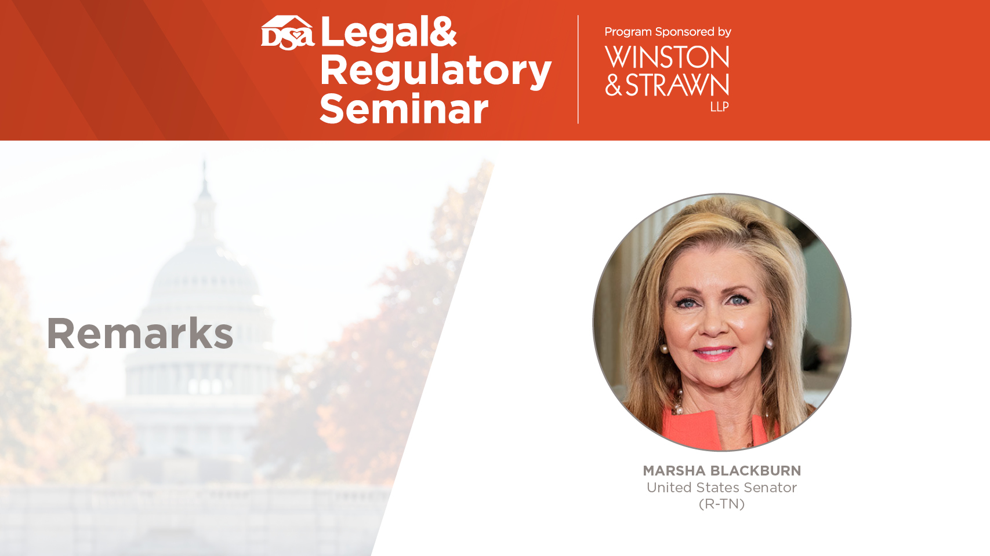

Slide 48


Slide 49


Slide 50
An Earnings Rule is Not Needed
FTC RATIONALE #1 - COMMENT IN ANPR
“Despite the Commission's aggressive enforcement program, deceptive earning claims continue to proliferate in the marketplace. The FTC continues to receive widespread reports from consumers and informants of misleading earnings claims.”
DSSRC Data Shows a Different Reality
Time Period | # of URLs Reviewed | # of Potentially Deceptive Claims | % of Potentially Deceptive Claims Compared to Entire Population of URLs Reviewed
3 year period | 900,000 (300,000 / yr) | 784 | .0008%
Total Cases Opened to Date | # of Cases Involving Earnings Claims | Main Issues
325 | 180 (55.4%) | 85% of 180 contained no disclosure or disclaimer
Notes:
DSA Response: The implication here is that misleading claims are so prevalent within the industry that a rule is needed to address this concern.
What substantiation does the FTC have when reaching such conclusions?
FTC continues to receive widespread reports from consumers and informants of misleading earnings claims.
They don’t have consumers calling in regarding compliant claims (only egregious non-compliant ones which reflect less than 1% of all claims out there). We only hear of crimes on the news, not crimes that didn’t happen which is the case 99.9% of the time.
DSA has evidence from the DSSRC that contradicts this:
The DSSRC has reviewed an average of 300,000 URLs per year. Within those 900,000 URLs, 784 were earnings claims deemed to be potentially deceptive to a reasonable consumer and removed from social media. That is only .0008% of the total URLs reviewed contained an earnings claim.
7.3 million independent salespeople in the direct selling industry daily, the number of posts are likely in the millions annually

Slide 51


An Earnings Rule is Not Needed
  Consumer Protections
Provisions prohibiting of false, deceptive or misleading earnings claims
Provisions requiring companies to present independent salesforce members with sufficient info to enable a reasonable evaluation of the opportunity to earn income
Provisions related to substantiation
Inventory Repurchase Agreement
DSSRC Data Since 2019
Number of Inquiries opened by DSSRC: 350
Total # of claims that have been taken down or significantly modified: 2,025 (more than ½ are earnings claims)
17 cases have been directly referred to the FTC by the DSSRC for potentially deceptive earnings and product claims.
Notes:
DSA, FTC and DSSRC all share in the same goal in preventing deceptive or misleading earnings claims and to ensure potential and current business participants have a reasonable expectation of income that can be earned.
The number of false and/or misleading earnings claims are low, because DSA takes its role seriously - DSA Code of Ethics provides consumer protection
Same with DSSRC - Self-Regulation works – DSSRC monitors and enforces a lot! – Look at the numbers. Plus there is a key training and educational component.

Slide 52
An Earnings Rule is Not Needed
FTC RATIONALE #2 - COMMENT IN ANPR
“In AMG Capital Mgmt., LLC v. FTC the Supreme Court ruled that the Commission may not seek equitable monetary relief under section 13(b) of the FTC Act for violations of the FTC Act or other statutes enforced by the Commission. While the Commission recently issued a Notice of Penalty Offenses concerning earnings claims, which will permit the Commission to seek civil penalties for misleading earnings claims in some cases, this authority does not provide a basis for the Commission to recover funds to return to injured consumers.”
“In addition, a rule would enable the Commission to seek monetary relief for consumers harmed by deceptive earnings claims, as well as civil penalties against those who make the deceptive claims.”
  Existing FTC Tools To Remove Deceptive Earnings Claims
  from the Marketplace Expeditiously and Collect Money for Consumers
  Filing administrative complaints alleging FTC Act violations and use Section 19 of the FTC Act to obtain monetary relief after the administrative action is complete.
    The FTC can bring an action under Section 13 for injunctive remedies as well.
  Filing joint actions with States (States’ ability to obtain monetary relief was not affected by AMG)
  Penalty Offense Authority can be used to quickly remove deceptive earnings claims and seeking civil penalties against those companies making misleading earnings claims
  Warning Letters
Notes:
FTC argues rule is needed since it lost its ability to seek monetary relief under 13(b)
We all agree that misleading claims need to be addressed. But FTC has several existing tools to remove deceptive earnings claims from the marketplace expeditiously and collect money from consumers

Slide 53
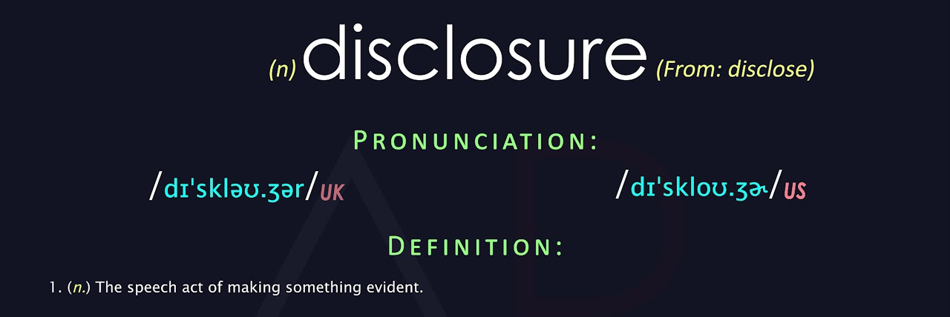
If the FTC Moves Forward with a Rule it Should Be Consistent with Existing Guidance and Precedent
FTC COMMENT IN ANPR
“In the Commission's experience, we have not seen probative evidence that disclaimers effectively cure atypical earnings claims. In Commission enforcement actions where defendants have argued that disclaimers or disclosures cured any deceptive earnings claims, courts have repeatedly found otherwise.”
Provide key, material information that helps clarify and qualify claims to avoid providing any misleading impressions that could be caused to the reasonable consumer.
Notes:
FTC alleges that in enforcement actions where defendants argue that disclaimers or disclosures cured any deceptive earnings claims, courts have found otherwise.
FTC fails to cite a single case in which a serious effort was made to use qualifications to present atypical earnings claims in a way that is not misleading to consumers.
In FTC cases where law enforcement actions were brought the advertising at issue either contained no disclosures at all, or in the few cases where disclosures were used the disclosures were clearly inadequate on their face because of an egregious lack of prominence, clarity or conspicuousness. This explains why the record is devoid of such cases where disclaimer effectiveness has been shown.

Slide 54

If the FTC Moves Forward with a Rule it Should Be Consistent with Existing Guidance and Precedent
FTC COMMENT IN ANPR
“In the Commission's experience, we have not seen probative evidence that disclaimers effectively cure atypical earnings claims. In Commission enforcement actions where defendants have argued that disclaimers or disclosures cured any deceptive earnings claims, courts have repeatedly found otherwise.”
Notes:
FTC alleges no probative evidence that disclaimers effectively cure atypical earnings claims
This is where the Twilight Zone moment occurs.

Slide 55
If the FTC Moves Forward with a Rule it Should Be Consistent with Existing Guidance and Precedent
FTC COMMENT IN ANPR
“In the Commission's experience, we have not seen probative evidence that disclaimers effectively cure atypical earnings claims. In Commission enforcement actions where defendants have argued that disclaimers or disclosures cured any deceptive earnings claims, courts have repeatedly found otherwise.”
Sources | Language
Dietary Supplements An Advertising Guide for Industry
“Thus, if an ad would be misleading without certain qualifying information, that information must be disclosed. For example, advertisers should disclose information relevant to the limited applicability of an advertised benefit.”
Enforcement Policy Statement Concerning Negative Option Marketing
“First, marketers must clearly and conspicuously disclose the material terms of a negative option offer including, at a minimum, key terms such as the existence of the negative option offer, the offer’s total cost, and how to cancel the offer.”
.com Disclosures: How to Make Effective Disclosures in Digital Advertising
“This document provides FTC staff guidance concerning the making of clear and conspicuous online disclosures that are necessary pursuant to the laws the FTC enforces.” - 4 P’s (prominence; presentation; placement; and proximity)
Soliciting and Paying for Online Reviews: A Guide for Marketers
“If you offer an incentive for a review, don’t condition it, explicitly or implicitly, on the review being positive. Even without that condition, the review should disclose the incentive, because its offer may introduce bias or change the weight and credibility that readers give the review.”
Guides for the Use of Environmental Marketing Claims (“Green Guides”)
“To prevent deceptive claims, qualifications and disclosures should be clear, prominent, and understandable. To make disclosures clear and prominent, marketers should use plain language and sufficiently large type, should place disclosures in close proximity to the qualified claim, and should avoid making inconsistent statements or using distracting elements that could undercut or contradict the disclosure.”
Guides Concerning the Use of Endorsements and Testimonials in Advertising
"If the advertiser does not have substantiation that the endorser’s experience is representative of what consumers will generally achieve, the ad should clearly and conspicuously disclose the generally expected performance in the depicted circumstances, and the advertiser must possess and rely on adequate substantiation for that representation.”
“It is an unfair or deceptive trade practice to misrepresent, explicitly or implicitly, that the represented profits or earnings are the ordinary, typical, or average profits or earnings made by participants. This includes by means of the representation of an earnings figure or the attribution of earnings figures to specific participants, both of which impliedly represent that such figures are likely, are earned by a substantial number of participants, or are the typical, ordinary, or average results, absent clear and conspicuous disclosure of the relevant context, such as the time and effort actually expended by participants who made the amount represented, the percentage of participants making the amount represented, and the amount typically and ordinarily made by participants."
FTC Penalty Offense Authority Letter
Press Release, FTC Staff Provides the FDA with Comments On First Amendment Commercial Speech Doctrine
The comment discusses disclosures at length, noting that “disclosures can qualify claims in many instances,” particularly when they are clear and prominent.
FTC Staff Comment to the US Mint Concerning Civil Penalties for Misuse of Mint Words, Letters, Symbols, and Emblems
The 2005 FTC staff comment explains that the Commission “generally has favored disclosures over banning claims as a means of curing deception” but did note that “disclosures do not always work. The comment then explains FTC principles on making sure that disclaimers or disclosures are clear and prominent.
The Commission ordered respondents to stop “[r]epresenting, directly or by implication, that persons purchasing respondents’ products can or will derive any stated amount of sales profits,” barred them from “[m]isrepresenting in any manner the past, present, or future sales profits or earnings from the resale of respondents’ products,” and required that testimonials from atypically successful purchasers include numerous disclosures, including the actual average of purchasers’ earnings or the percentage of purchasers earning the stated amount.
National Dynamics Corp., 82 FTC 488, modified at
85 FTC 1052 (1975)
Notes:
There are numerous examples of FTC cited sources explaining that atypical earnings claims can be cured with a clear and conspicuous disclaimer. FTC even has guidance on what an effective disclaimer should contain – 4 Ps - .com Disclosure Guides

Slide 56
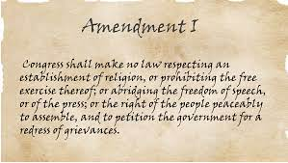


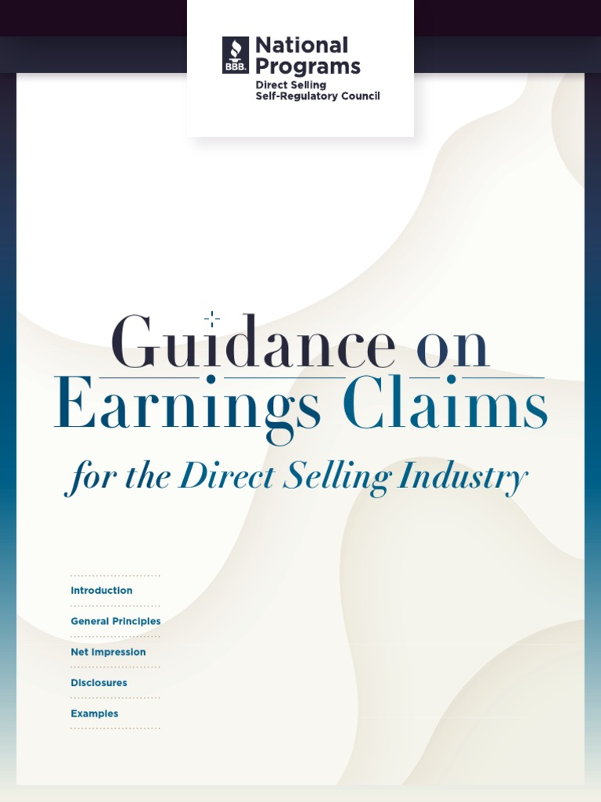





Additional Considerations
1st Amendment Implications
Impact to Other Companies
Established Advertising Principles
Company Compliance
Self Regulation
Compliant
Claims
Notes:
There are other things that need to be considered when deciding whether or not to create a rule that goes against existing FTC precedent allowing for atypical claims to be made with a clear and conspicuous disclosure:
1st Amendment
Provides substantial protections for truthful commercial speech, including advertising about income opportunities
Restrictions on commercial speech must be closely scrutinized and narrowly tailored
Government interest must be substantial
Regulation must directly advance government interest
Actions taken must not be more extensive than is necessary to serve that interest
FTC reports refer to government’s limited ability to restrict commercial speech with respect to banning qualifications and disclosures in advertising
Impact to Other Companies
A rule that would ban the use of anything other than typical earnings claims would reflect a fundamental shift in FTC jurisprudence, and there has been no authority cited supporting any reason to single out earnings claims for such special treatment while allowing the use of disclaimers in other contexts.
Notably, the FTC would be making this seismic shift only with respect to earnings claims without any clear rationale as to why earnings claims would or should be treated differently from the broad array of other advertising claims that also have the potential to create deception if clarifying information is not adequately disclosed.
Burden on Businesses: Prohibiting direct sellers from speaking about truthful earnings that go beyond the typical experience would greatly burden millions of American small businesses. DSA believes these messages can be communicated with appropriate disclosures consistent with pre-existing regulatory and self-regulatory guidance.
Advertisers in every industry, from direct sellers to car manufacturers, to insurance companies, to telecommunicators, to travel companies use clear and conspicuous disclaimers to effectively qualify claims. The ramifications of a rule based upon a false premise that disclaimers are ineffective to qualify claims would be contradictory to years of advertising precedent and practices.
Net Impression Standard is what determines what is or is not misleading: FTC Should follow general advertising review principles of net impression. They have not provided any substantive evidence or data showing ineffectiveness of clear and conspicuous disclosures. In fact, John Villafranco is going to present evidence to the contrary in a bit showing how disclosures are effective in qualifying claims.
The FTC should also consider a company’s compliance efforts that encourage robust training, compliance and monitoring while not punishing companies in the event that a small number of distributors make problematic statements.
Effectiveness of Self Regulation
Monitor / Enforce: We saw the numbers earlier showing the effectiveness of DSSRC’s monitoring and enforcement efforts
Educate / Train: DSSRC Guidance on How to Make Atypical Earnings claims which are consistent with other principles of longstanding FTC jurisprudence on advertising

Slide 57

Kingsley Study
Objective: through qualitative and quantitative testing, determine consumer understanding of income disclosures that qualify atypical results
Conducted by Barbra Kingsley, PhD
  Co-founder of the Kingsley-Kleimann Group
  Over 25 years of experience testing and developing disclosures and other consumer perception evidence.

Slide 58


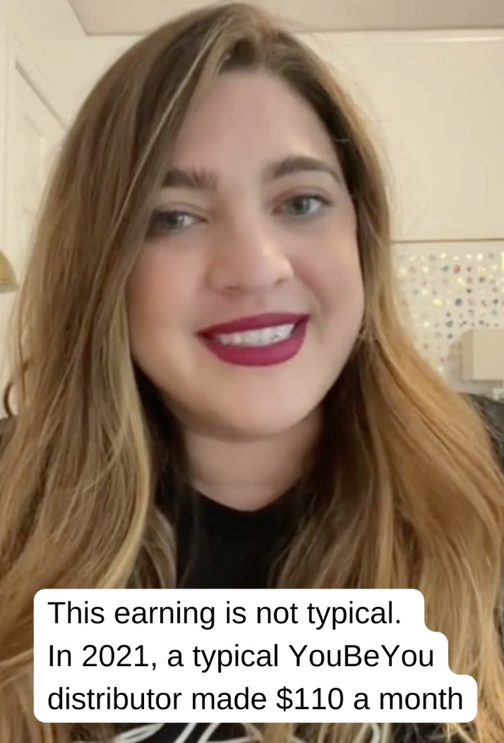
Quantitative Study Design
2337 participants.
Stimulus - Social media videos/3 types representing a hypothetical direct selling company called You Be You:
  1) actor playing in a park
  2) actor presenting tickets she bought with earnings
  3) actor with shake discussing positive aspects of being a distributor
Disclosure Types: 3 disclosure types for each stimulus
  No Disclosure
  Spoken Disclosure: “Now, this amount is not typical. Most people don’t make this much. A typical You Be You distributor makes $110 a month.”
  Written Disclosure: “This earning is not typical. In 2021, a typical You Be You distributor made $110 a month.”

Slide 59
Quantitative Test Procedures & Results
Participants were exposed to the videos and then asked an open-ended and then a closed ended question: “According to this video, how much does a typical You Be You distributor earn?”
The overwhelming majority of participants were able to identify typical earnings to a statistically significant degree with most iterations of each showing comprehension of disclosures between 80 and 90 percent.
When participants answered incorrectly and were shown another disclosure modeled as part of a registration process, most correctly identified typical earnings – increasing the overall percentage of participants who demonstrated an understanding of typical earnings to virtually all (91.2 percent) survey participants.
The survey evidence establishes that consumers read and understand disclosures of atypical earnings, and thus, demonstrates that consumers would not be misled by an appropriately qualified earnings claim.

Slide 60


Slide 61


Slide 62
FTC Act, Section 5
"unfair or deceptive acts or practices in or affecting commerce, are hereby declared unlawful."
15 U.S.C. § 45(a)(1)

Slide 63
Koscot (1975)
“The operation of a pyramid scheme constitutes an unfair or deceptive act or practice in or affecting commerce for the purposes of § 5(a).”

Slide 64
Koscot (1975)
A pyramid is characterized by payment by participants of money to the company in return for which they receive
the right to sell a product and
the right to receive in return for recruiting other participants into the program rewards which are unrelated to the sale of product to ultimate users.

Slide 65
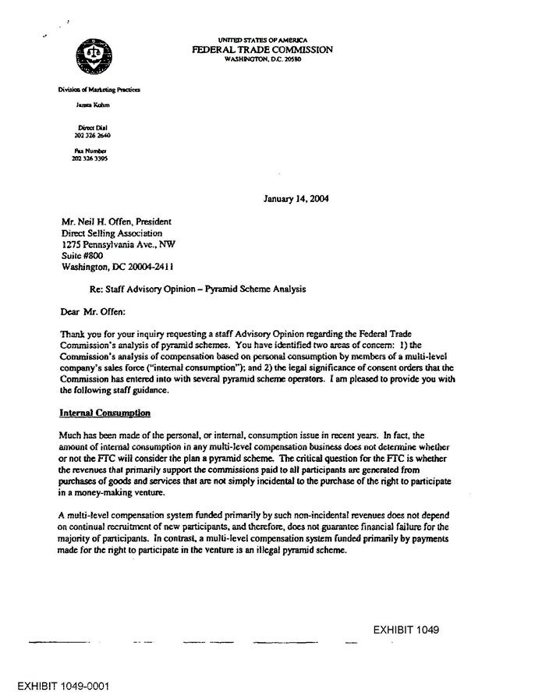
FTC Staff Advisory Opinion (2004)

Slide 66
FTC Staff Advisory Opinion (2004)
The critical question for the FTC is whether the revenues that primarily support the commissions paid to all participants are generated from purchases of goods and services that are not simply incidental to the purchase of the right to participate in a money-making venture.”

Slide 67
FTC v. BurnLounge (9th Cir. 2014)
Not all MLM businesses are illegal pyramid schemes. To determine whether a MLM business is a pyramid, a court must look at how the MLM business operates in practice.
BurnLounge's focus was recruitment and the rewards it paid, in the form of cash bonuses, were primarily for recruitment rather than for sales of merchandise.

Slide 68
FTC v. BurnLounge (9th Cir. 2014)
BurnLounge's focus was in promoting the program rather than selling the products.
Participants earned rewards by recruiting others to join the scheme, i.e., by recruiting new participants to buy packages. . . . but the rewards the participants received in return were largely for recruitment, not for product sales.

Slide 69
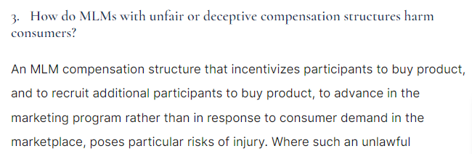
FTC Business Guidance
Concerning MLM (Jan. 2018)

Slide 70
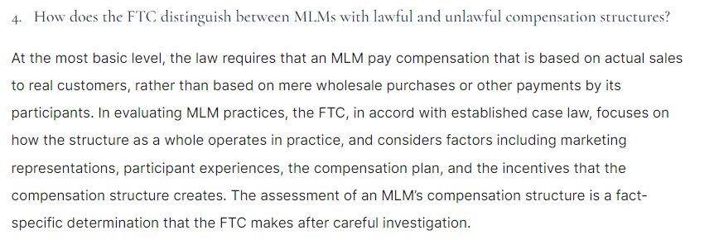
FTC Business Guidance
Concerning MLM (Jan. 2018)

Slide 71
FTC v. Noland, Success By Health
(D. Arizona 2020)
Court Order Granting FTC Motion for Preliminary Injunction
SBH’s sales videos and transcripts . . . show that SBH and Noland focus overwhelmingly on recruitment as the path to commissions and profits. [Discussion] about the importance of retail sales . . . are drowned out by the drumbeat of constant emphasis on recruiting other Affiliates and profiting from a cut of the commissions earned by downline Affiliates.

Slide 72
FTC v. Noland, Success By Health
(D. Arizona 2020)
Court Order Granting FTC Motion for Preliminary Injunction
Admission that the profits an SBH Affiliate might earn through retail sales . . . are trivial and that the commission plan is actually “driven” by the potential profits to be earned by qualifying for the BAM bonus (which is “phase six” and requires, in its highest form, the recruitment of over 100,000 people).

Slide 73
FTC v. Noland, Success By Health
(D. Arizona 2020)
Court Order Granting FTC Motion for Preliminary Injunction
Courts also consider whether the company has promulgated, and effectively enforced, policies to prevent inventory loading. . . . SBH does not even attempt to track Affiliates’ retail sales or track how much inventory a particular Affiliate possesses.

Slide 74
FTC v. Financial Education Services
(E.D. Michigan 2022)
FTC Memo of Law in Support of Preliminary Injunction
Based on his evaluation of the FES compensation plan and policies and procedures, the FTC’s expert Dr. David Givens determined that Defendants’ payment and bonus structure for FES Agents incentivize recruiting new FES Agents rather than focusing their time or energy on selling FES products.

Slide 75
FTC v. Financial Education Services
(E.D. Michigan 2022)
FTC Memo of Law in Support of Preliminary Injunction
The Receiver reports that “it appears that Agents are heavily incentivized to recruit other potential Agents to increase their compensation.”
Dr. Givens is clear that his “conclusions about the investment opportunity would hold even if the services offered by FES . . . delivered real value to consumers.”

Slide 76
FTC Complaint Overview
General bipartisan agreement at FTC
Difficult to read tea leaves
Analyzing complaints versus orders
Heavy negotiations in orders
What are the essential provisions
Tremendous variability
Commonalities in recent MLM complaints

Slide 77
Complaint Commonalities
Unrelated to structure
  Earnings claims
    Broad agency interest
    Get people to sign up regardless of structure
  “Confusing” or “convoluted” compensation plans
  High turnover

Slide 78
Complaint Commonalities
Bad documents help to frame legal arguments
  More than just color in a complaint
    “I’m not selling [product] . . . Im selling stay at home mommies . . . We sell freedom. We don’t sell [product]”
    “Number one: Recruit. Number two: recruit. Number three: Recruit.”
    “It’s wonderful that we have everybody consuming and we have everybody doing the different methods of retail . . . but you got to think about it, guys, the name of the game here is royalty . . . and you don’t get paid royalty off of customers.”

Slide 79
FTC Complaint Structural Commonalities
Emphasis on recruiting over sales to consumers outside organization
Business model makes it unlikely to earn money by selling to outside consumers in response to genuine demand
Limited profit margins for retail sales
Rules that limit or restrict retail sales
Product availability through other channels makes sales more challenging
Thresholds that limit sales commissions

Slide 80
FTC Complaint Structural Commonalities
Recruitment vs. Retail
Defendants provide no guidance on where to market or sell products.
Teach Affiliates to give away the products as samples and to concentrate their efforts on recruiting new participants
No meaningful discounts or incentives to encourage retail sales
Retail sales just mitigate participation costs
Print materials emphasize recruitment over retailing
Compensation for recruitment dwarfs what might be made from retail sales

Slide 81
FTC Complaint Structural Commonalities
Purchase Trends
Incentivize commitments to designated volumes of product purchases per month
Substantial upfront investments
Timing of purchases – to meet thresholds and early in the process
Product purchases driven by compensation plan and not consumer demand
Personal monthly auto-delivery

Slide 82
FTC Complaint Structural Commonalities
Powerful incentives to recruit more participants
Lack of tracking of purchases and lack of connection between compensation plan and retail sales
High concentration of rewards among a small number of distributors

Slide 83
Keeping Your Business Model Legal
Starter Kits
Enrollment Packs
Bundles of Products
Require on enrollment?
How expensive can they be?
Commissionable volume
Encouraging purchase of “samples” to give away

Slide 84
Keeping Your Business Model Legal
Bonus programs
Promotions
Recruiting contests
Fast Start Bonuses
Incentivizing recruitment over product sales
Contests that focus on recruitment
Bonuses disproportionate to product sales

Slide 85
Product Considerations
Selling products in packages, and not a la carte
Product pricing considerations
  Expensive products; intrinsic value of product
  Commissions disproportionate to product price
  Pricing of competitive products in the marketplace
  Are overpriced products a hidden recruitment fee?
Would someone buy the product “but for” the business opportunity?

Slide 86
Compensation Plan Incentives
Monthly qualification requirements
  Buying products vs. selling of products
  Personal product purchases by distributor
  Autoship
Incentives to buy products for reasons other than consumption
Rank advancement requirements
Emphasis of recruitment over product sales

Slide 87
Purchases For Reasons Other Than Consumption
Mandatory purchase requirements
  Pay to Play
Safeguards Against Inventory Loading
  Limits on quantity of product a distributor can purchase at one time
  Purchasing more product than distributor can expect to consume; purchasing for re-sale?
  70% Rule: still relevant?

Slide 88
Economic Framework
A Pyramid Scheme is a recursive arrangement in which a participant pays into a scheme in return for the right to earn commissions on the payments made by others whom she recruits and convinces to chase the same opportunity
A pyramid scheme is a recruitment-based negative wealth transfer scheme in which the payments of newer entrants are transferred to earlier entrants
This framework essentially describes a chain letter scheme
  Givens in FTC v. FES (2022): “An MLM amounts to a pyramid scheme if, like a chain letter, its compensation structure makes recruiting necessary for success”

Slide 89
Economic interpretation of the second prong of the Koscot test
The right to receive in return for recruiting other participants into the program rewards that are unrelated to the sale of products to ultimate users
Because of the vagueness of prong two, economists need to state their understanding of it
  Example 1: Givens in FTC v. FES (2022)
  “I interpret the Koscot language to place the endless-chain element at the center of a determination of whether an MLM is operating as a pyramid scheme”

Slide 90
Economic interpretation of the second prong of the Koscot test
  Example 2: Vender Nat (2015)
    “In an MLM context, an organization is a pyramid scheme if it rewards participants primarily for recruitment, while the firm’s product is incidental to the proposed business opportunity. Moreover, the incidental nature of the product is chiefly evidenced by the payment of recruitment rewards having no cognizable or substantive relation to retail sales, i.e., sales to consumers who buy the product for their own end-use and are not incentivized to buy product for the sake of the business opportunity”

Slide 91
A description of an analytical framework that FTC consumer protection economists use to assess MLM organizations
Wosinska et al. (2021)
  Compensation Plan, Promotional Materials, and Distributor Training
  Simulated Participation Scenario
  Distributor Data
    the degree and profitability of retail activity
    the size and timing of wholesale purchases, and what that timing may indicate regarding the motivations for purchasing
    who receives recruitment-based earnings and how much?
      a highly unequal distribution is consistent with commission flows within a chain letter scheme
    how long distributors participate in the MLM before quitting the business opportunity

Slide 92
What percentage of an MLM’s volume is attributable to genuine economic demand?
To assess the volume attributable to sales to consumers who buy the product for their own end-use and are not incentivized to buy product for the sake of the business opportunity, we investigate three categories of volume:
Volume sold to final users (“Amway defense”)
Volume attributable to new members
Volume driven by strategic purchases

Slide 93
Volume sold to final users
Field Retail Resale
Personal Purchases
Member Purchases
Personal Consumption
Genuine Demand
Direct Sales to Preferred and Retail Customers

Slide 94
Volume attributable to new Members
Front loading occurs when new distributors drive a disproportionately large share of total sales in an effort to advance in the compensation plan
New distributors are encouraged to purchase substantially more product than they can expect to sell to retail customers
If volume attributable to new Members constitutes a relatively high share of overall volume, it could suggest that the front-loading of payments from new Members is used to fund company’s operation, as well as returns to Members who joined earlier and have a higher position in the hierarchy

Slide 95
Volume attributable to strategic behavior
Purchases motivated by Members’ desire to qualify for certain bonuses
  Minimum purchase requirement
  Autoship
Purchases concentrated towards the end of the qualification period
Donations (if commissionable)

Slide 96
Is the product competitive?
Wosinska et al. (2021):
  Given the wholesale price, retail demand conditions, and potential competition from other distributors, could retailing be profitable, and—if so—at what scale?
Is there evidence of deeply discounted sales on Amazon, eBay, etc?
How does the product compare with similar products sold through the traditional brick and mortar channel?

Slide 97
Compensation plan considerations
Eliminate rewards that encourage recruitment
  Rewards that are directly linked to recruitment
  Rewards available only to participants who recruited others
Eliminate rewards that are not directly linked to genuine demand
  Minimum purchase requirements that can only be satisfied through Distributors’ personal purchases
  Rewards that encourage front loading and inventory loading
  Rewards that increase exponentially with greater levels of expenditure
Reward only receipted sales to final Customers

Slide 98
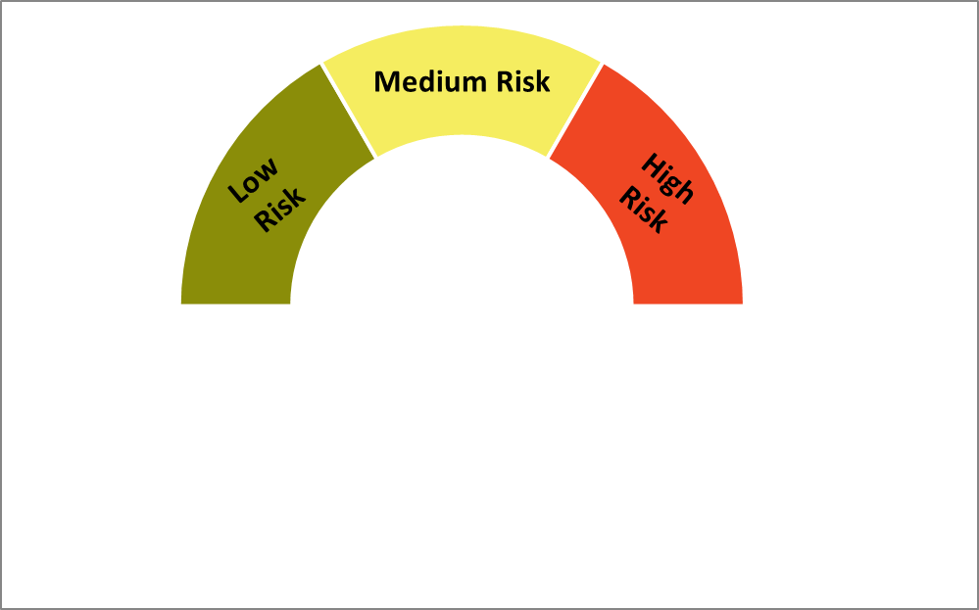
It’s a continuum…

Slide 99
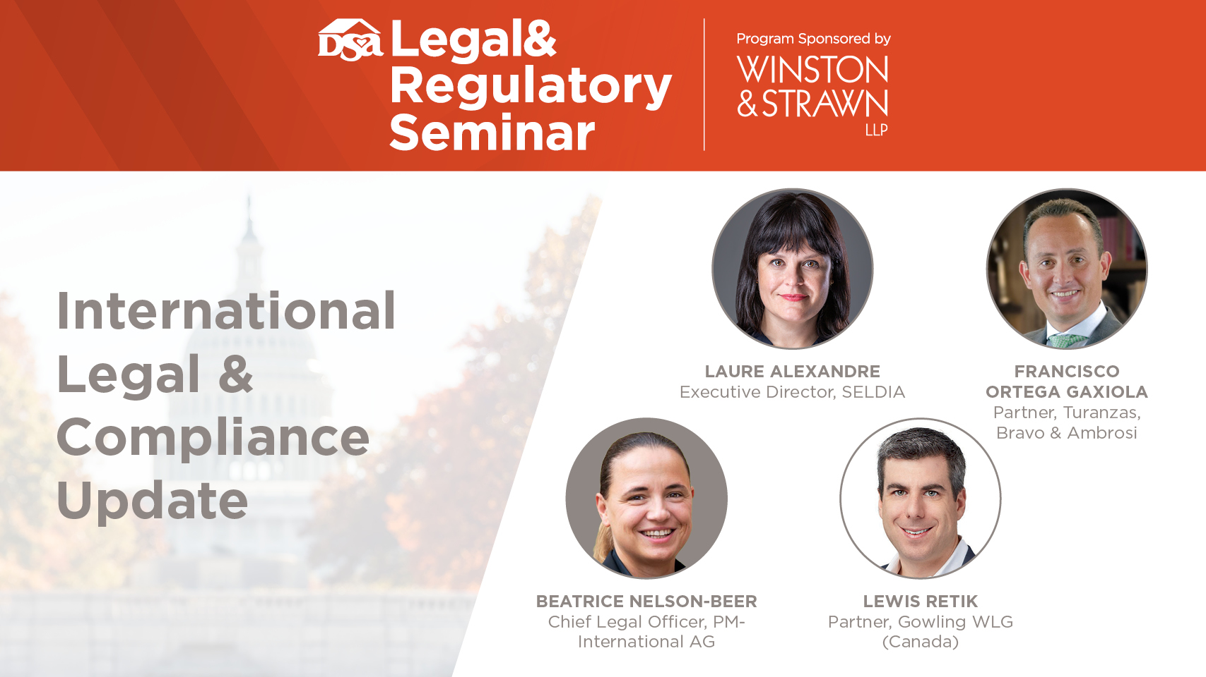

Slide 100
EU Policy Objectives
Digital Transition
Green Transition
An open, democratic and sustainable society
Cut greenhouse gas emissions by at least 55% by 2030
Economic growth decoupled from resource use
“No person and no place left behind”
A fair and competitive digital economy
Technology that works for the people
No net emissions of greenhouse gases by 2050
Notes:
DSA / DMA
Platform Work
Digital Fairness
Data and Privacy
EU Green Deal

Slide 101
Proposal For Directive On Improving Working Conditions In Platform Work
09 Dec 2021: Commission proposal published
EU draft criteria on presumption of employment status of platform workers ​
Focus on misclassification of platform workers as self-employed​
Rules on declaration of platform work, right of redress and sanctions
>> Focus on on-demand services (“work provided at the request of the recipient of the service”)

Slide 102
Commission Proposal - Criteria
(art 4) If two of the following five criteria are fulfilled, there is a legal presumption of employment relationship between platform and platform worker:
  Effectively determining, or setting upper limits for the level of remuneration
  Requiring the person performing platform work to respect specific binding rules with regard to appearance, conduct towards the recipient of the service or performance of the work
  Supervising the performance of work or verifying the quality of the results of the work including by electronic means
  Effectively restricting the freedom, including through sanctions, to organise one’s work, in particular the discretion to choose one’s working hours or periods of absence, to accept or to refuse tasks or to use subcontractors or substitutes;
  effectively restricting the possibility to build a client base or to perform work for any third part
Platforms would have the right to contest this classification, with the burden of proof resting on them (principle of rebuttable presumption).

Slide 103
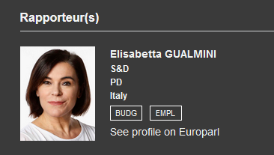

Negociations Ongoing
European Parliament
Council of the European Union
Notes:
Definitions of digital labour platforms & platform worker
Departs from the EP Resolution of 16 September 2021 adopted by a large majority, defining digital labour platforms as “companies which intermediate or offer, with a greater or lesser extent of control, on-demand services”.
Focus on algorithmics management: To qualify as a “digital labour platform” natural or legal persons should use “automated or semi-automated processes and algorithms for intermediating, supervising or organising in any way the work performed by individuals, irrespective of whether that work is performed online or in a certain location”.
Push to define what is an independent contractor instead of a platform worker
Legal Presumption of Employment Status
The Rapporteur now considers that “providing the worker with tools, digital means, materials or machinery that are necessary for the performance of the work” or “providing the worker with training” should be seen as establishing the presumption of employment status.
Proposed amendment: “Where a digital labour platform decides – on a purely voluntary basis or in agreement with the persons concerned – to pay for social protection, accident insurance or other forms of insurance, training measures or similar benefits to self-employed persons working through that platform, those benefits as such should not be regarded as determining elements indicating the existence of an employment relationship”.

Slide 104
Timeline
19 May | EP: Rapporteur Report
Trilogues to take place in 2023​
16 June | Council : Progress report
12 July | EP: Exchange in EMPL
25 Oct | EP: Vote in EMPL
Dec 2022 | EP: Vote in Plenary
Dec 2022​ | Counci: General Approach

Slide 105
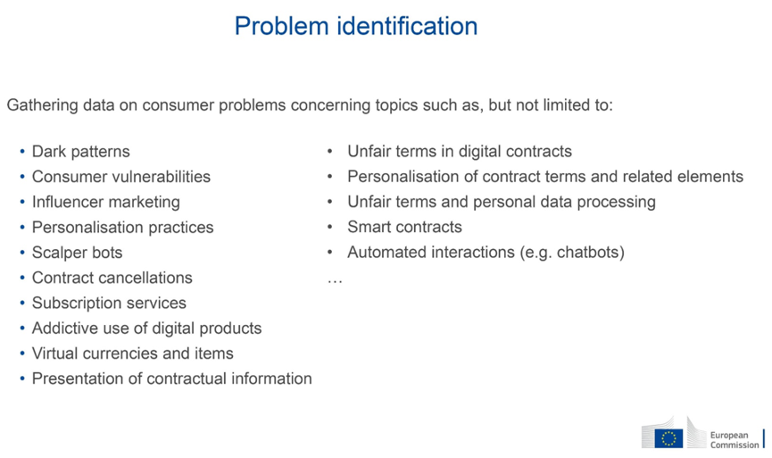
Digital Fairness (Review of EU Consumer Directives)
Notes:
Review of the following Directives:​
a) Unfair Commercial Practices Directive​
b) Consumer Rights Directive​
c) Unfair Contract Terms Directive​
​
Banning certain commercial practices (Annex 1 of Unfair Commercial Practices Directive)​
​
Additional obligations for traders (online interface neutrality, fairness principle)

Slide 106
Timeline
17 May: Call for Evidence
25 Oct: CPAG presentation
Q2 2024: Proposal expected
Seldia consulted
members > Submission on 14 June​
2023: Impact
assessment
Q4 2022: Commission to launch public stakeholder consultation

Slide 107
Revision of ADR Directive​
Directive 2013/11: Alternative Dispute Resolution Directive (EU rules on out-of-court consumer complaints handling)​
Ongoing revision of ADRD + Online Dispute Resolution Regulation + 2017 Regulation on consumer protection cooperation between authorities​ (CPC)
Public stakeholder consultation launched on 4 April​ / closed on 27 June​
Seldia submitted contribution​
Results awaited​
CPAG to discuss Commission ongoing work on 25 October​
​Legislative proposal expected first quarter of 2023
Notes:
Are consumers aware of ADR and other out of court options?​
​​
How to improve awareness? What is the role of trade associations in promoting ADR?​
​
How to encourage use of the ADR system by consumers? (e.g. guidance on cross-border cases)​
​
Purpose of review: ​
​
How to improve cooperation of authorities for cross-border cases?

Slide 108
Sustainability and Climate Initiatives​
30 March 2022
Circular Economy Action Plan
30 Nov
Circular Economy II Package
30 Nov
Climate Package
Notes:
SPI
Improve durability / repairability ​
Reduce environmental footprint​
Restrict single-use ​
Set mandatory green procurement criteria ​
Improve product information (Digital Product Passport)

Slide 109
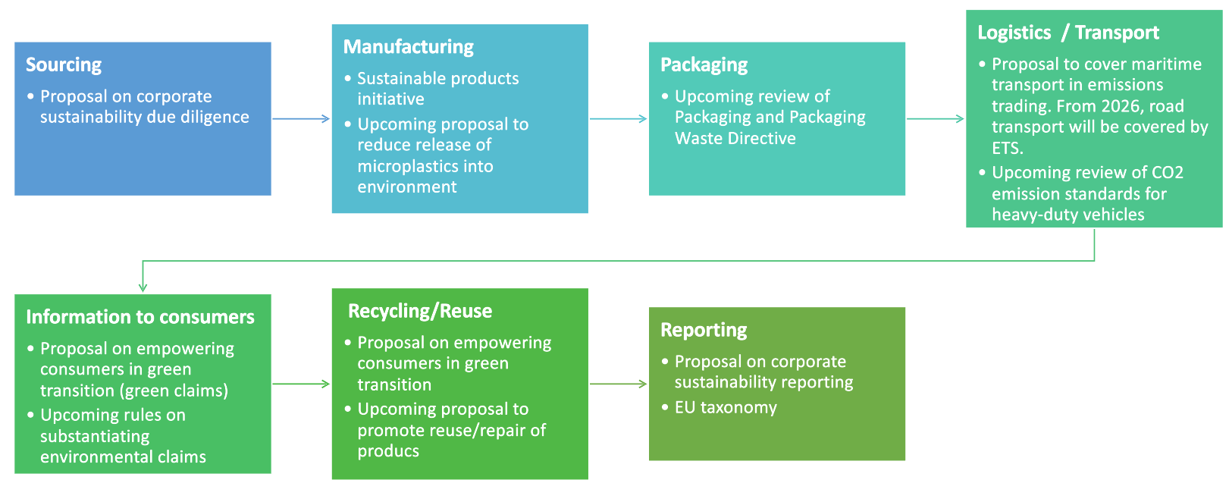
EU initiatives impacting the supply chain

Slide 110
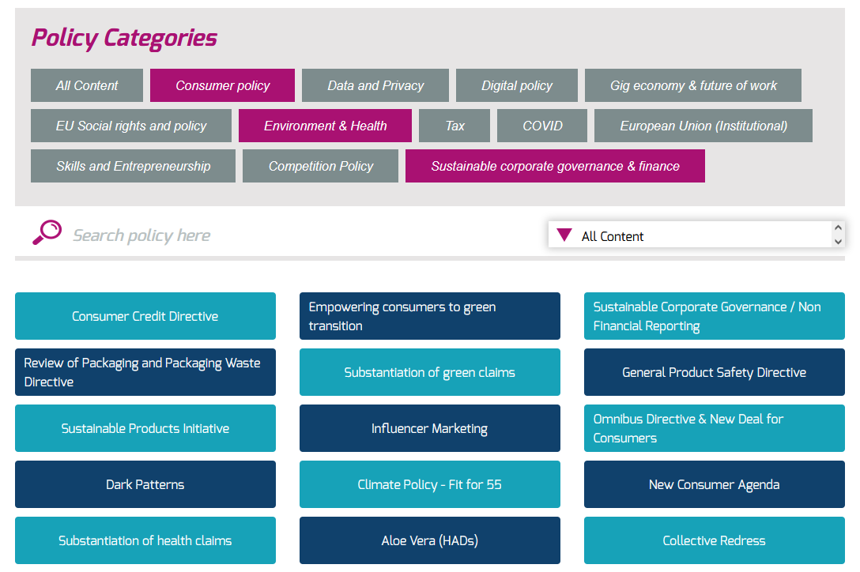
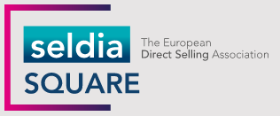

Slide 111


Slide 112


Slide 113


Slide 114


Slide 115


(A)(8)(b) - Earnings Representations
Member companies must comply with, and obligate their independent salespeople to also comply with, the following standards:
  Earnings representations and sales figures must be truthful, accurate, and presented in a manner that is not false, deceptive or misleading.
  Current and prospective independent salespeople must be provided with sufficient information to understand that:
    Actual earnings can vary significantly depending upon time committed, skill level and other factors;
    Not everyone will achieve the represented level of income; and
    Such amounts are before expenses, if any.

